Slide 1
流感的流行病學
李雋元
高醫附院 感染科

Slide 2
大綱
在COVID-19疫情下，流感的疫情如何呢?
在COVID-19疫情下，其它呼吸道病毒的疫情如何呢?
放寬non-pharmaceutical interventions管制後，呼吸道感染的疫情可能會如何呢?
為什麼我們要來認識流感的威脅呢?
流感的症狀、併發症與其它病原菌的共同感染
抗藥性流感病毒株

Slide 3
大綱
在COVID-19疫情下，流感的疫情如何呢?
在COVID-19疫情下，其它呼吸道病毒的疫情如何呢?
放寬non-pharmaceutical interventions管制後，呼吸道感染的疫情可能會如何呢?
為什麼我們要來認識流感的威脅呢?
流感的症狀、併發症與其它病原菌的共同感染
抗藥性流感病毒株

Slide 4
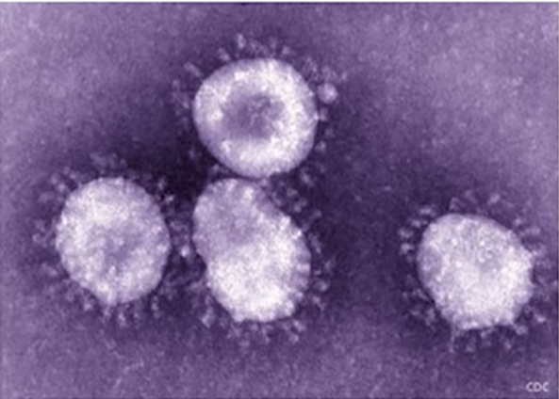
在COVID-19疫情下，流感的疫情如何呢?

Slide 5
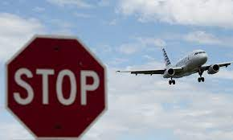

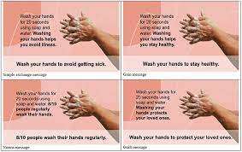



Travel restrictions
Environmental disinfection
Messaging on handwashing
Lockdowns
Physical distancing
Use of face coverings

Slide 6

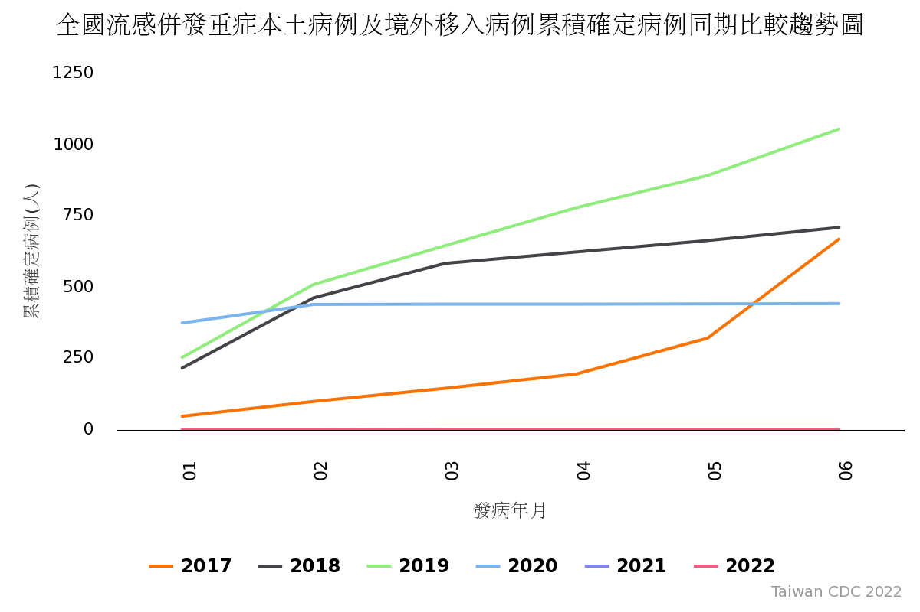
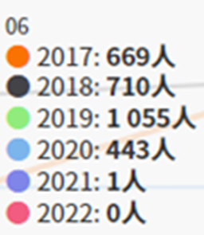
Last update: 2021/8/20

Slide 7

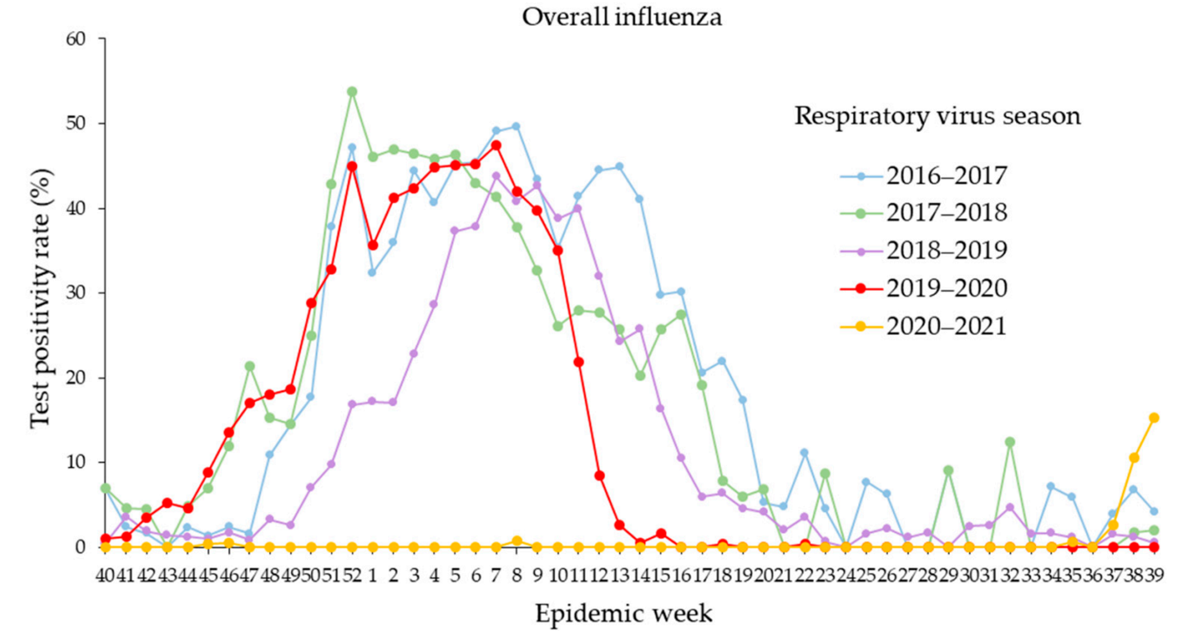
National COVID-19 emergency delcared
Decreased influenza activity during the COVID-19 pandemic-United States, Australia, Chile, and South Africa, 2020
2019-2020, a rapid declining
In the United States, influenza virus circulation declined sharply within 2 weeks of the COVID-19 emergency declaration and widespread implementation of community mitigation measures, including school closures, social distancing, and mask wearing, although the exact timing varied by location
Int J Environ Res Public Health. 2022 May 13;19(10):5942

Slide 8
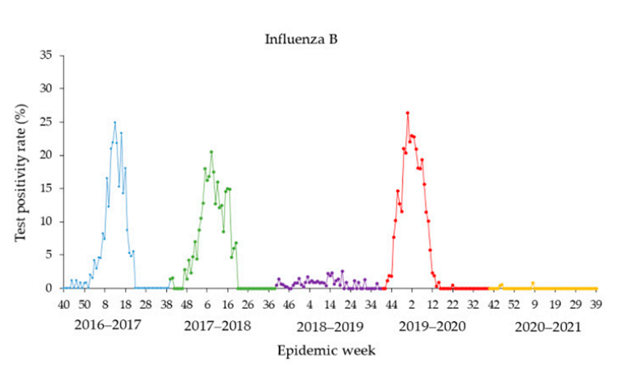
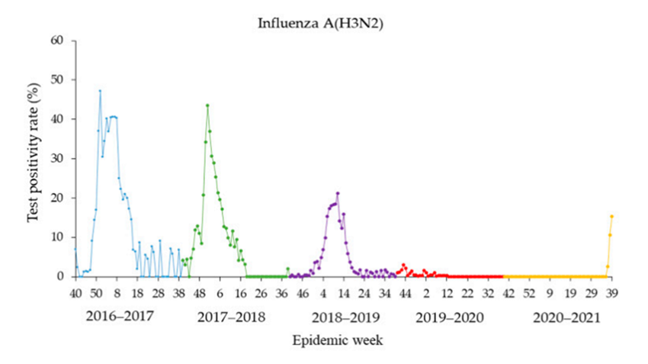
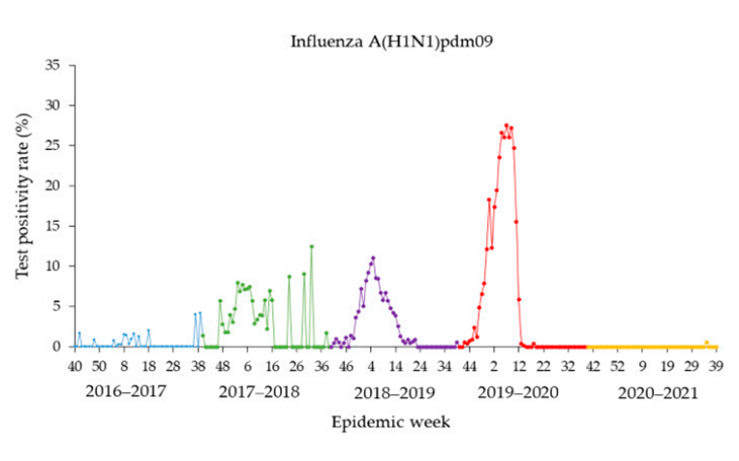
Int J Environ Res Public Health. 2022 May 13;19(10):5942

Slide 9

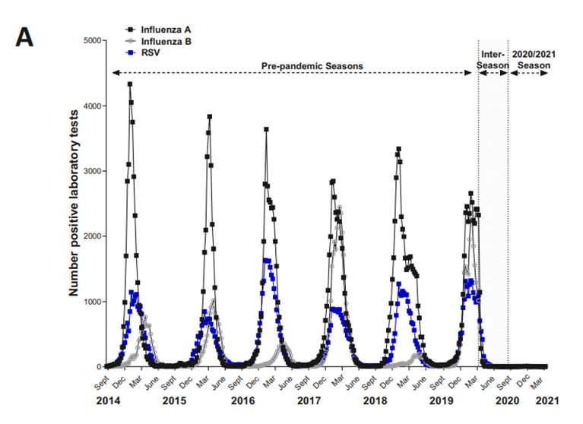
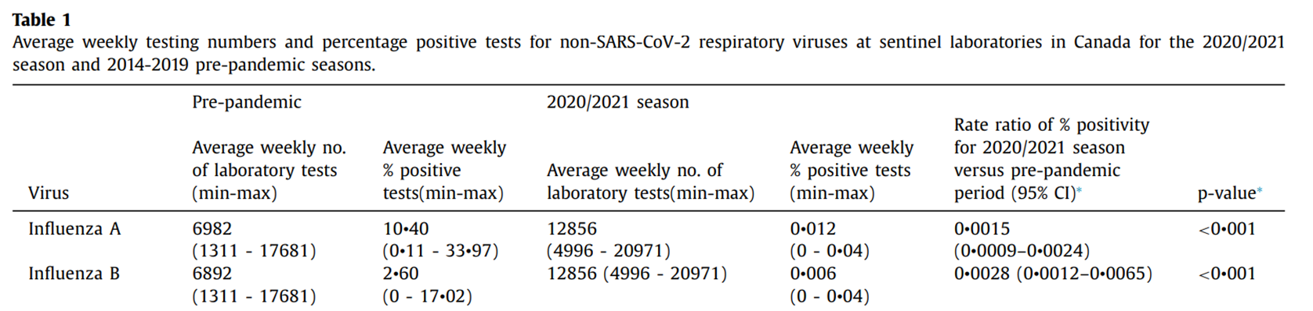
The impact of the COVID-19 pandemic on influenza, respiratory syncytial virus, and other seasonal respiratory virus circulation in Canada: A population-based study
For influenza A and B, the percent positive decreased to 0.0015 and 0.0028 times that of pre-pandemic (2014-2019) levels respectively
Lancet Reg Health Am. 2021 Jul 17;100015

Slide 10
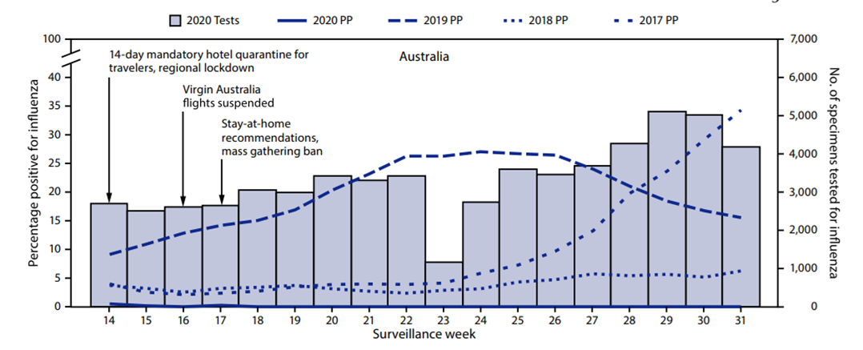

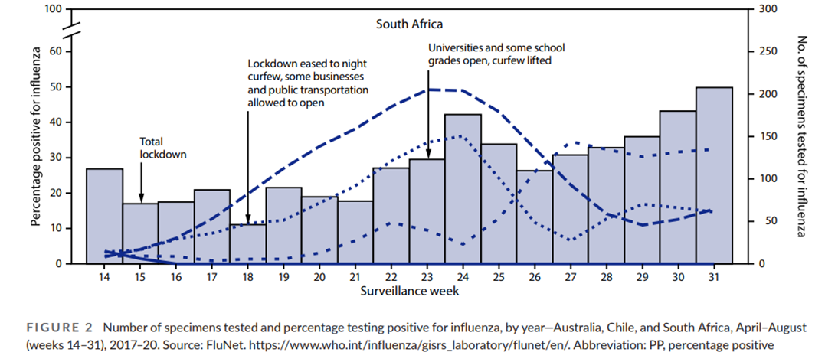

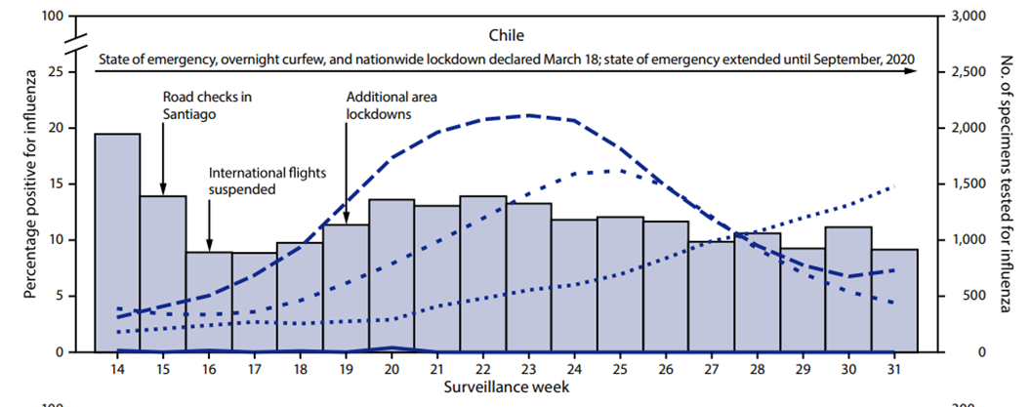

2019-2020
Influenza data reported to the World Health Organization’s (WHO’s) FluNet
platform from three Southern Hemisphere countries that serve as robust sentinel sites for influenza from Oceania (Australia), South America (Chile), and Southern Africa (South Africa) showed very low influenza activity during June–August 2020, the months that constitute the typical Southern Hemisphere
influenza season
2019-2020
2019-2020
MMWR Morb Mortal Wkly Rep. 2020 Sep 18;69(37):1305-1309

Slide 11
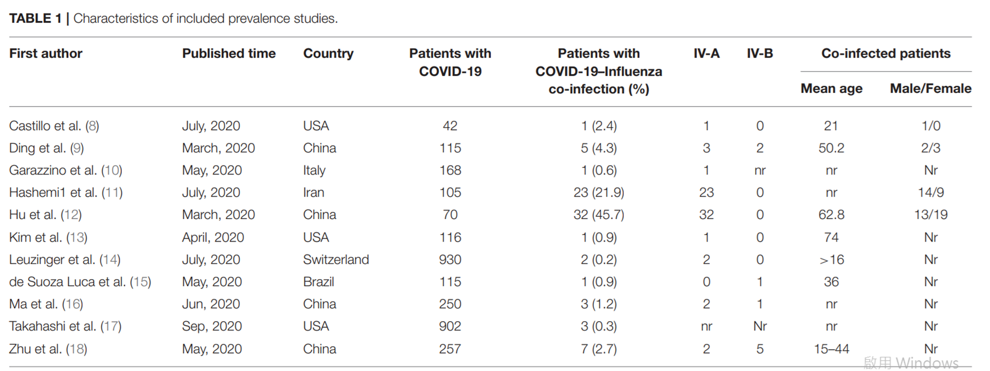
COVID-19 and Influenza Co-infection: A Systematic Review and Meta-Analysis
The prevalence of influenza infection was 0.8% in patients with confirmed COVID-19. The frequency of influenza virus co-infection among patients with COVID-19 was 4.5% in Asia and 0.4% in the America.
Front Med (Lausanne). 2021 Jun 25;8:681469.

Slide 12
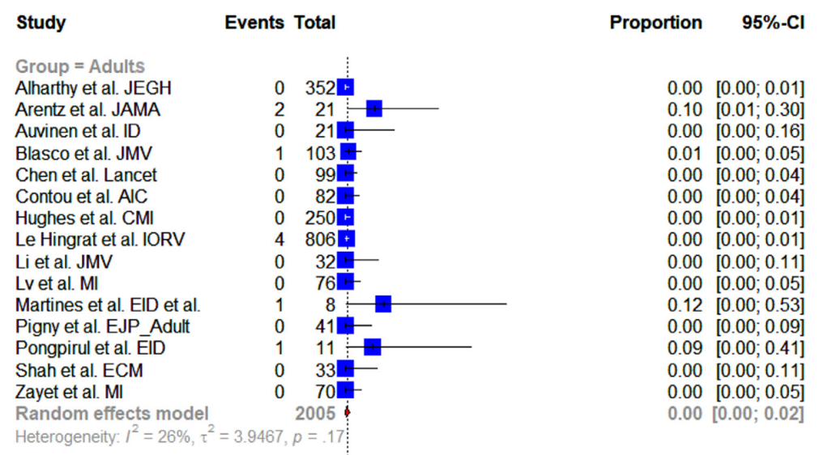
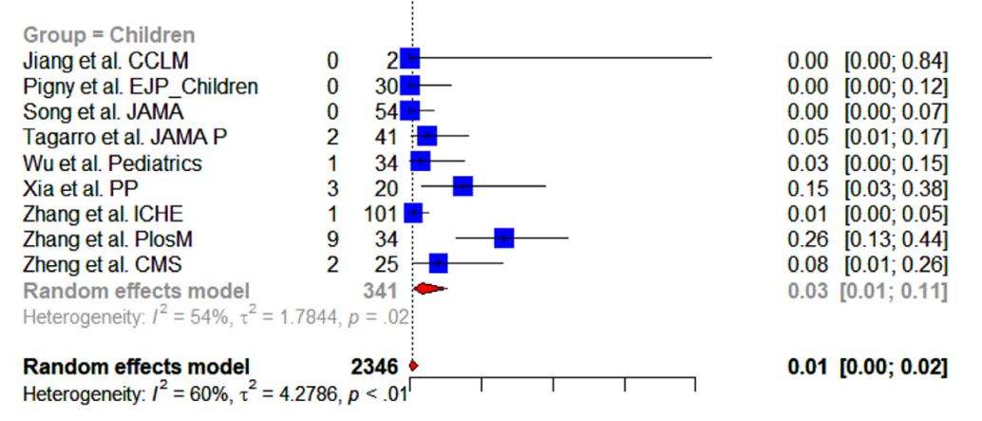
Rates of co-infection with SARS-CoV-2 and influenza virus in COVID-19 children and adult patients
18,021 patients infected with SARS-CoV-2 who were tested for influenza viruses.
Of them, 143 patients were co-infected.
The proportion of co-infection in children was 3.2%, 95% CI = [0.9– 10.9] and that among adult patients was 0.3%, 95% CI = [0.1 – 1.2]
J Clin Virol Plus. 2021 Sep;1(3):100036.

Slide 13

Conclusions
The global trends of season influenza decline because of widespread implementation of measures to mitigate transmission of SARS-CoV-2.
Therefore, the co-infection of influenza and COVID-19 remain low.

Slide 14
大綱
在COVID-19疫情下，流感的疫情如何呢?
在COVID-19疫情下，其它呼吸道病毒的疫情如何呢?
放寬non-pharmaceutical interventions管制後，呼吸道感染的疫情可能會如何呢?
為什麼我們要來認識流感的威脅呢?
流感的症狀、併發症與其它病原菌的共同感染
抗藥性流感病毒株

Slide 15
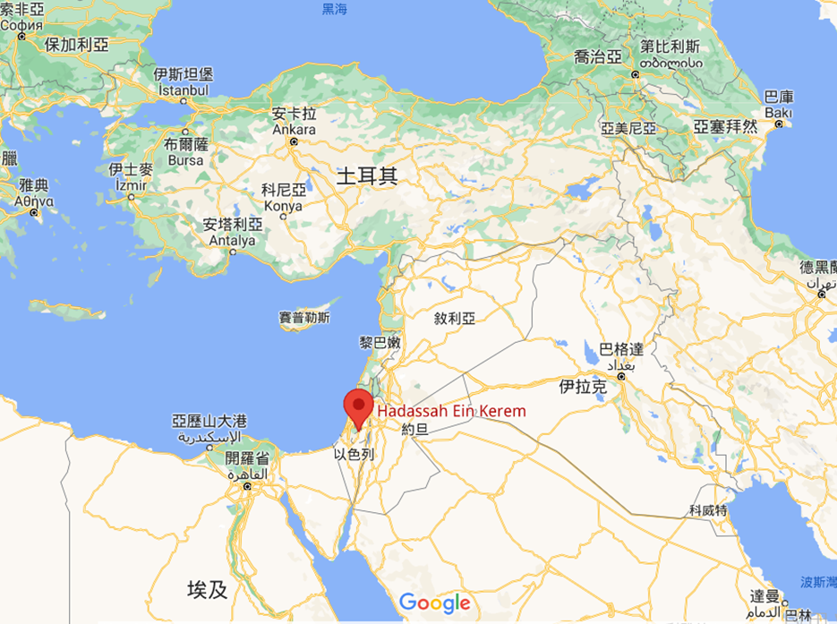

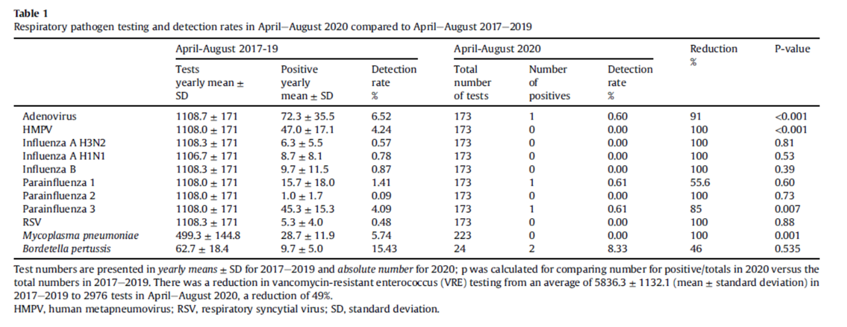
Hospitalized patients in Hadassah Medical Center (1100 inpatient beds tertiary medical centre in Jerusalem), April-August 2020.
Clin Microbiol Infect. 2020 Dec 31;27(5):811-812.

Slide 16
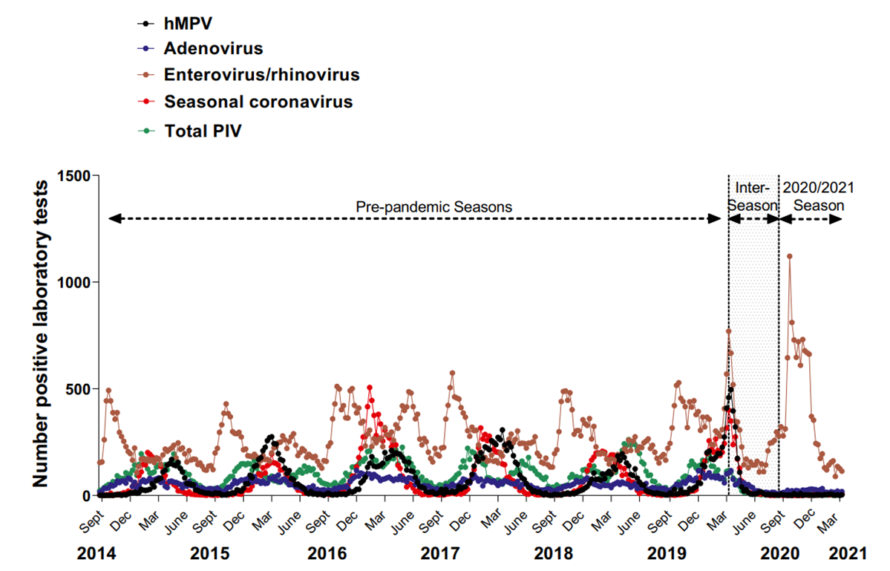
Lancet Reg Health Am. 2021 Jul 17;100015

Slide 17
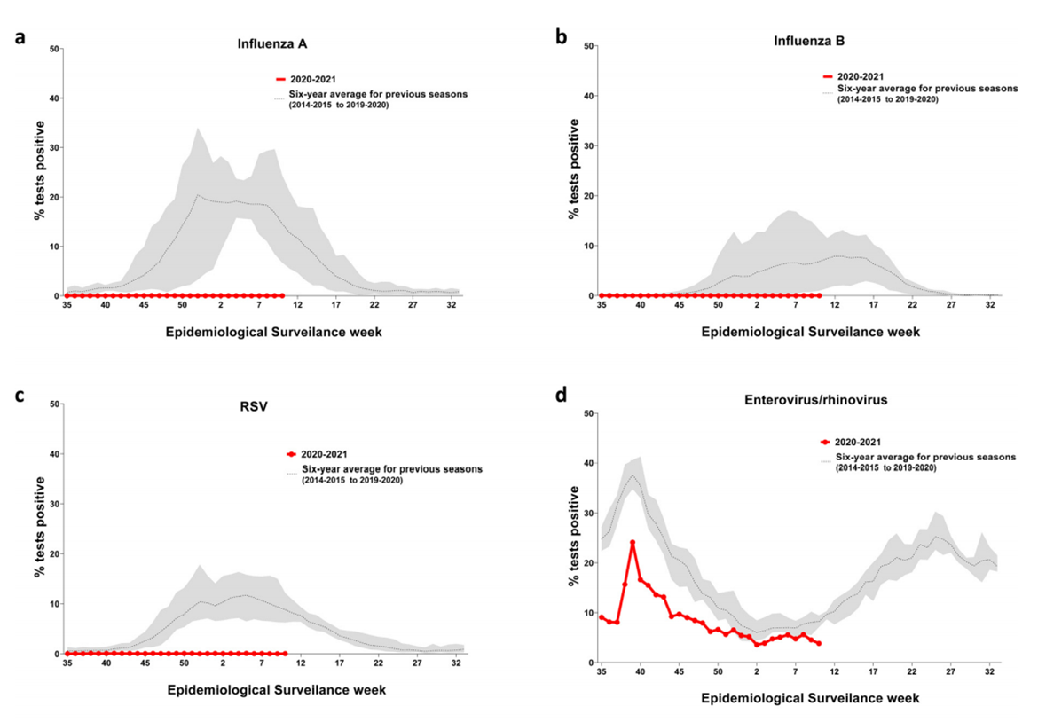
Lancet Reg Health Am. 2021 Jul 17;100015

Slide 18
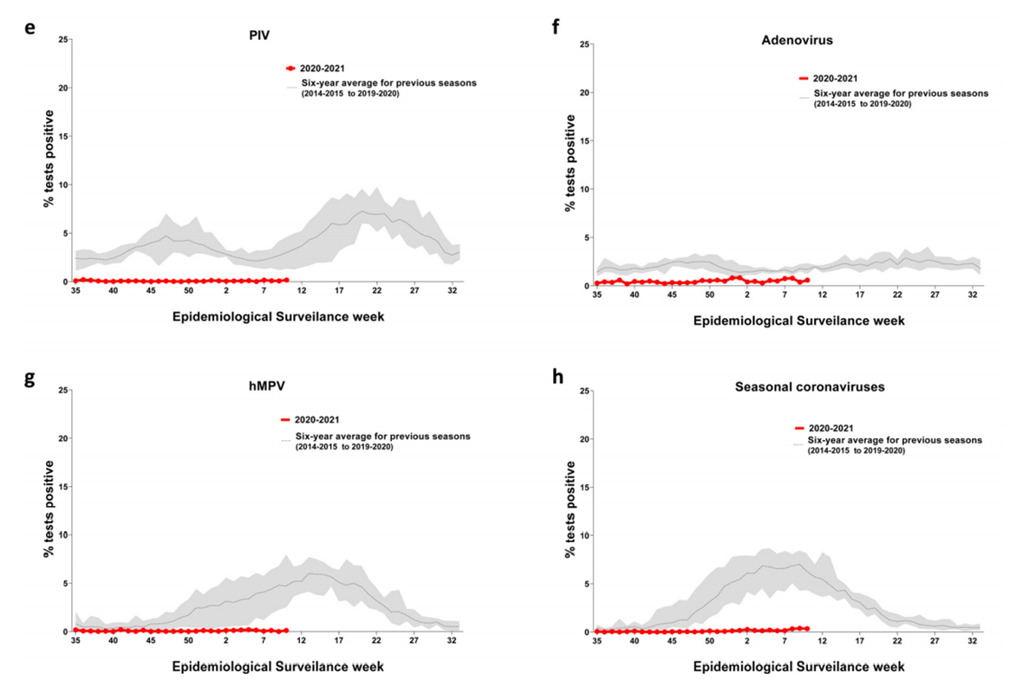
Lancet Reg Health Am. 2021 Jul 17;100015

Slide 19
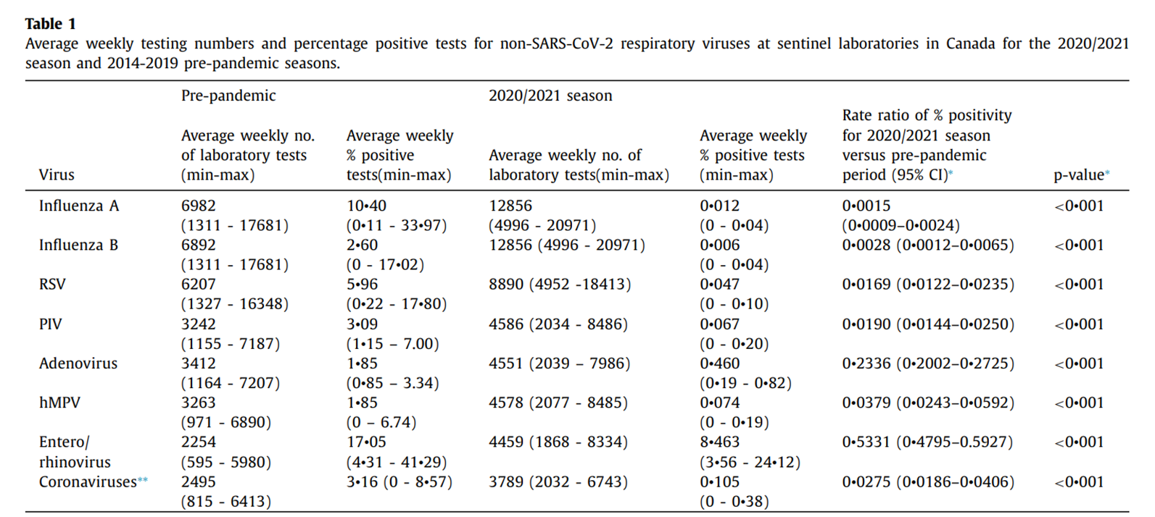
We report an effective absence of the annual seasonal epidemic of most seasonal respiratory viruses in 2020/2021. This dramatic decrease is likely related to implementation of multi-layered public health measures during the pandemic. The impact of such measures may have relevance for public health practice in mitigating seasonal respiratory virus epidemics and for informing responses to future respiratory virus pandemics
Lancet Reg Health Am. 2021 Jul 17;100015

Slide 20
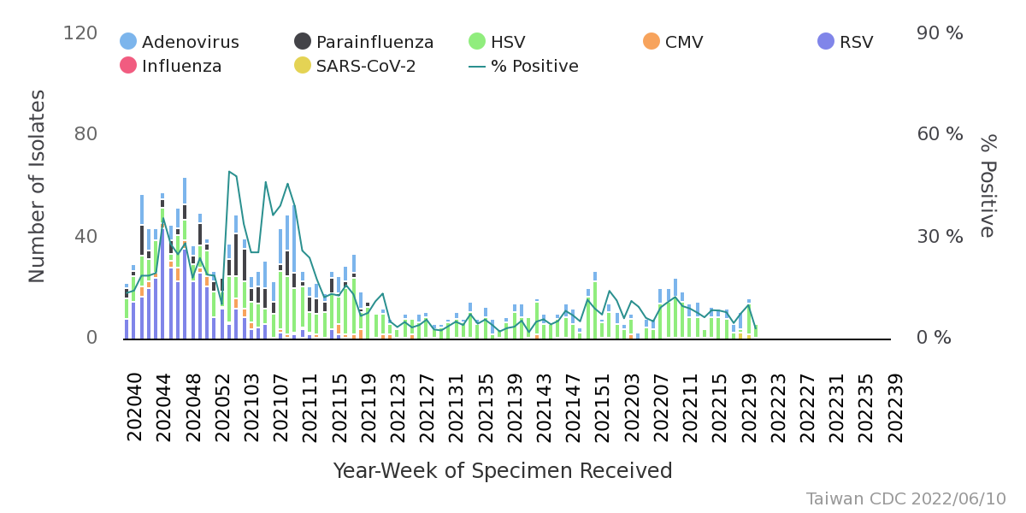

Slide 21
大綱
在COVID-19疫情下，流感的疫情如何呢?
在COVID-19疫情下，其它呼吸道病毒的疫情如何呢?
放寬non-pharmaceutical interventions管制後，呼吸道感染的疫情可能會如何呢?
為什麼我們要來認識流感的威脅呢?
流感的症狀、併發症與其它病原菌的共同感染
抗藥性流感病毒株

Slide 22

Int J Environ Res Public Health. 2022 May 13;19(10):5942

Slide 23
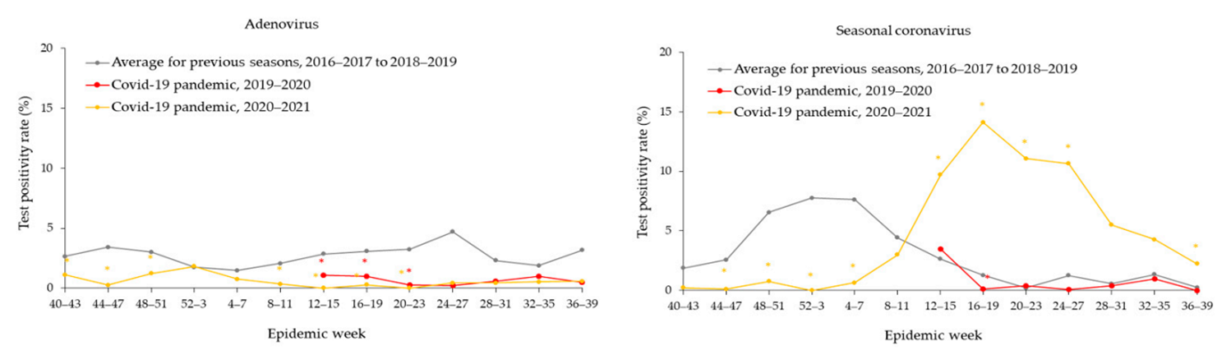
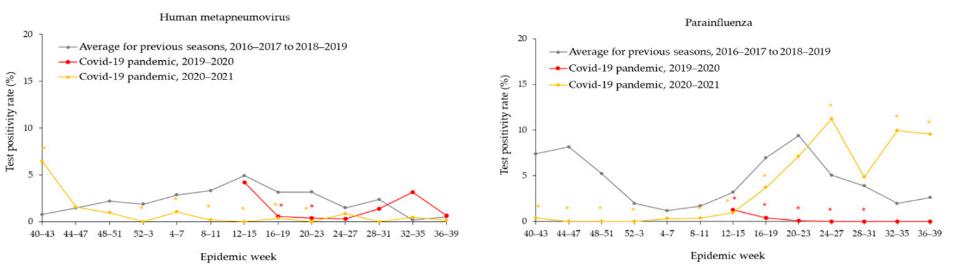
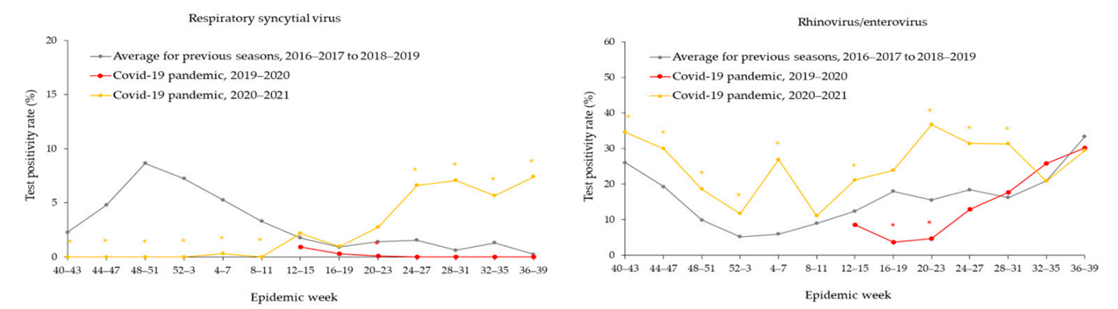
許多呼吸道病毒(seasonal coronavirus, parainfluenza, RSV, rinhovirus/enterovirus)隨著隔離政策的鬆綁，疫情有復燃的跡象。
Int J Environ Res Public Health. 2022 May 13;19(10):5942

Slide 24
大綱
在COVID-19疫情下，流感的疫情如何呢?
在COVID-19疫情下，其它呼吸道病毒的疫情如何呢?
放寬non-pharmaceutical interventions管制後，呼吸道感染的疫情可能會如何呢?
為什麼我們要來認識流感的威脅呢?
流感的症狀、併發症與其它病原菌的共同感染
抗藥性流感病毒株

Slide 25
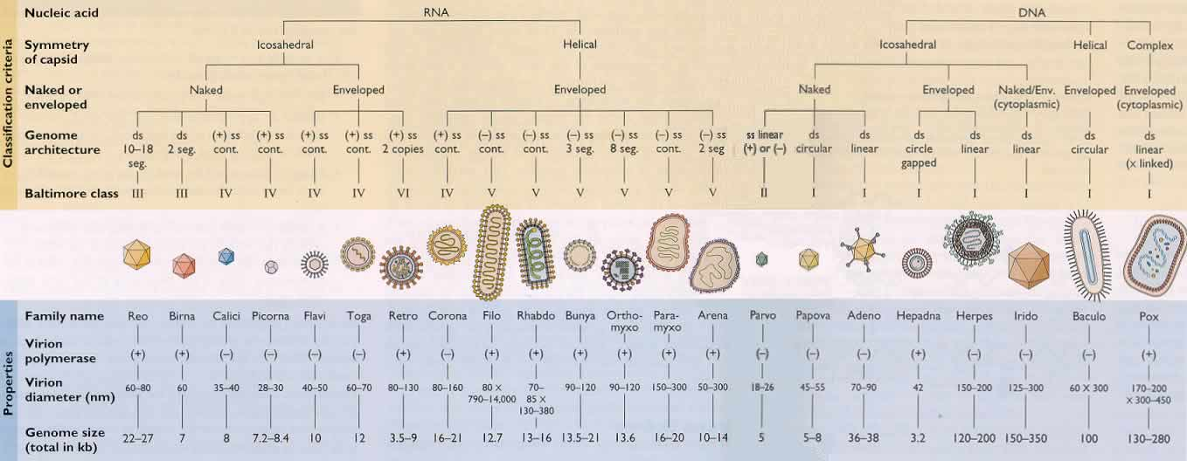
病毒分類
流感病毒為RNA病毒, 屬正黏液病毒科（Orthomyxoviridae family)

Slide 26
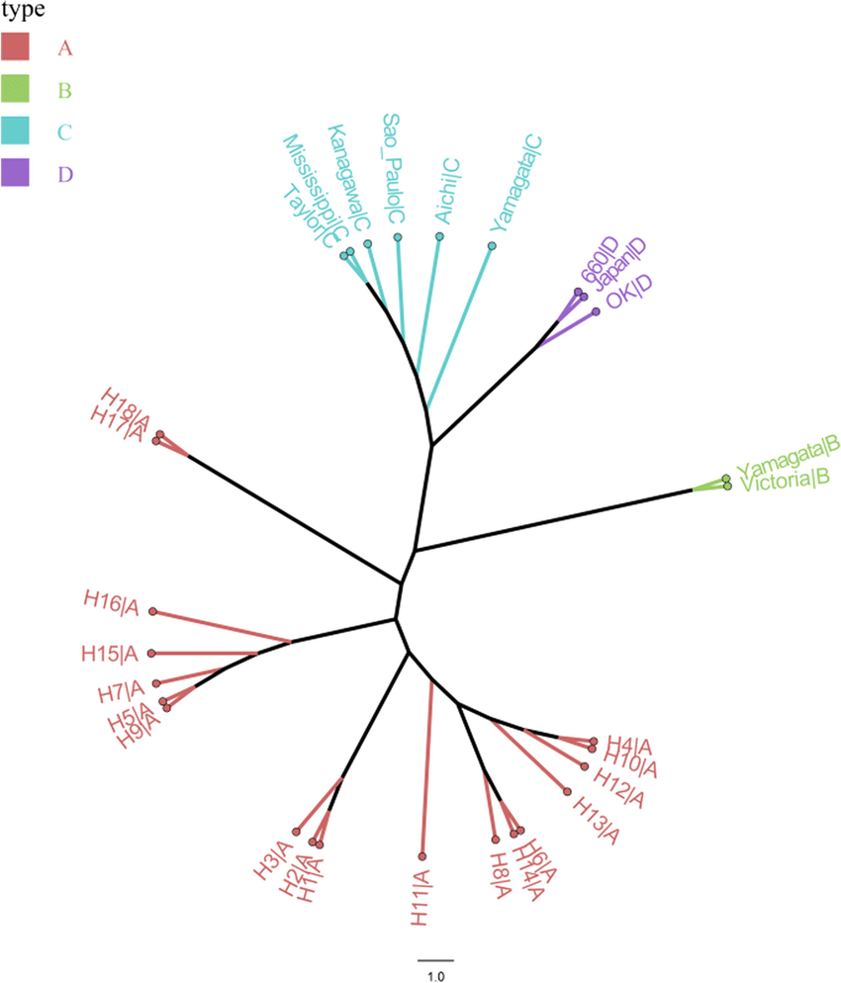
Phylogenetic tree of Infuenza viruses based on PB2 sequences
流感病毒可以分為: type A、 type B、 type C、 type D:
只有type A、 type B、 type C會感染人類。
Type C流感很罕見，只會造成輕微的上呼吸道感染。
Virol J. 2021 Nov 22;18(1):230.

Slide 27
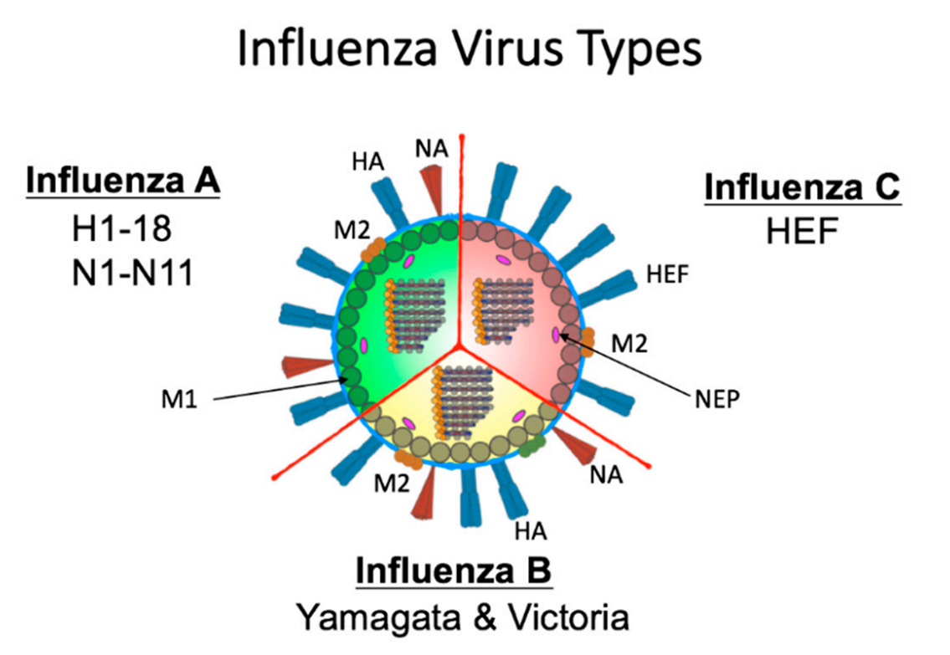
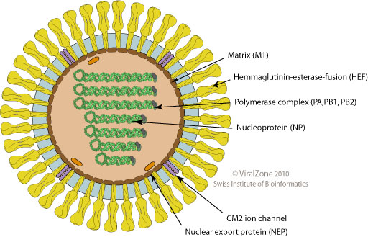
A、B 、C型流行性感冒病毒的結構
Influenza C
Subtype
CM2
The surface of influenza C virus is defined by a single spike protein referred to as hemagglutinin-esterase-fusion glycoprotein (HEF).
This protein has host receptor binding abilities, membrane fusion capabilities, and enzymatic activity for egress.
BM2
Lineage
Viruses. 2019 Jan 30;11(2):122.
Notes:
. Schematic of Influenza A, B, and C virus structure. Influenza A is defined by its surface proteins hemagglutinin (HA) and neuraminidase (NA) of which there are 18 HA and 11 NA. Influenza B viruses are categorized into two lineages (B/Yamagata and B/Victoria). The surface of both A and B viruses contains HA, NA, and the M2 proteins. Internally, A and B viruses both have eight genomic segments. Influenza C viruses have only one external spike protein (HEF) which functions both in viral entry and egress and an ion channel M2 protein. Type C viruses have 7 internal genomic segments. M1 protein line the envelope internally adjacent nuclear export protein (NEP) proteins for type A, B, and C viruses. The genomic segments are encapsidated by the NP protein and form the ribonucleocapsid with the polymerase proteins Polymerase acidic (PA), Polymerase basic 1 (PB1), and Polymerase basic 2

Slide 28
 | A型流感病毒 | B型流感病毒 | C型流感病毒
基因結構 | 有八個基因片段 | 有八個基因片段 | 有七個基因片段
病毒體結構 | 11個蛋白質 | 11個蛋白質 | 9個蛋白質
抗原變異種類 | Antigenic drift, antigenic shift | Antigenic drift | Antigenic drift
抗原變異性 | 變異性大,可能會發生抗原性大變異,會產生一個新的病毒株 | 抗原變異性較穩定 | 抗原性非常穩定
自然界宿主 | 人,豬,馬,禽鳥類,哺乳動物 | 人,海豹 | 人,豬
引起疾病嚴重度 | 高危險群感染後容易引發嚴重併發症,且所引起之症狀最嚴重 | 引起症狀較A型輕微,通常會於老年人及幼童等高危險群發生嚴重併發症 | 症狀較輕微,甚至無症狀
發生流行程度 | 易發生變異,如出現一種新的病毒亞型,將會引起全球大流行 | 引可能發生”Antigenic drift”,故恐會引起地區性的流行 | 無季節性
A 型流感病毒除了感染人類，還可能出現跨物種間的傳播，如豬、馬、雞、鴨等，而B 型則至今只曾出現在人類 (其餘只有在雪貂和海豹有表現出對B型流感的敏感性)。
只有A型與B型可以引起大規模的季節性流行。

Slide 29
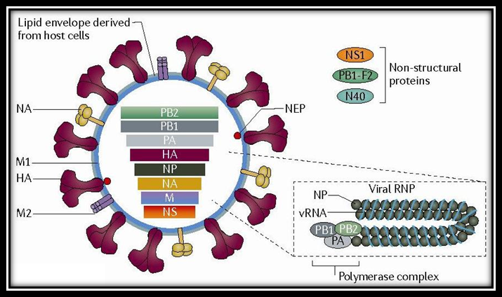
PB1, PB2, PA節段編碼的是RNA聚合酶（RNA polymerase）
HA節段負責編碼血球凝集素
NP節段負責編碼核蛋白（nucleoprotein）
NA節段編碼的是神經胺酸酶
M節段編碼基質蛋白
NS節段編碼的是具有剪接RNA（RNA splicing）功能的非結構蛋白（nonstructural protein)
A型可依表面抗原血球凝集素（H 抗原）及神經胺酸酉每（N 抗原）的不同，還可分為許多亞型：
其中H 抗原亞型共有18 種，為H1-H18。
N 抗原亞型共11 種，為N1-N11。
B 型及C 型流感病毒則不區分亞型
Notes:
Hemaglutinin (HA) binds sialic acid residues on the cell surface, allowing the virus to enter the cell by endocytosis.
M2 is an ion channel that is activated by low pH.

Slide 30
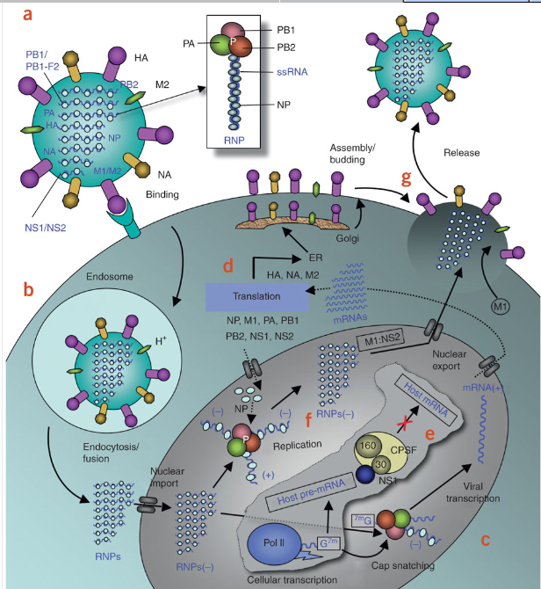
A型流感的生命週期
Hemagglutinin (HA) ：
Receptor binding (sialic acid)
Membrane fusion
Neutralizing antibody target
Neuraminidase (NA)：
Remove sialic acid residues
Virion release
Ion channel (M2)：
H⁺-dependent uncoating
Influenza A only
Nature Structural & Molecular Biology 17,530–538(2010
Notes:
(a) Influenza A virus has a lipid bilayer envelope, within which are eight RNA genomic segments, each of which is associated with the trimeric viral RNA polymerase (PB1, PB2, PA) and coated with multiple nucleoproteins (NPs) to form the vRNPs. The outer layer of the lipid envelope is spiked with multiple copies of HA, NA and a small number of M2, whereas the M1 molecules keep vRNPs attached to the inner layer. (b) The viral surface glycoprotein HA binds to the host cell-surface sialic acid receptors, and the virus is transported into the cell in an endocytic vesicle. The low pH in the endosome triggers a conformational change in the HA protein that leads to fusion of the viral and endosomal membranes. The low pH also triggers the flow of protons into the virus via the M2 ion channel, thereby dissociating the vRNPs from M1 matrix proteins. The vRNPs that are released into the cytoplasm are transported into the nucleus by recognition of the nuclear localization sequences (NLSs) on nucleoproteins83 only when the M1 molecules are dissociated. (c) In the nucleus, the viral polymerase initiates viral mRNA synthesis with 5′-capped RNA fragments cleaved from host pre-mRNAs. The PB2 subunit binds the 5′ cap of host pre-mRNAs84, and the endonuclease domain in PA subunit cleaves the pre-mRNA 10–13 nucleotides downstream from the cap85. Viral mRNA transcription is subsequently initiated from the cleaved 3′ end of the capped RNA segment85, 86. This 'cap snatching' occurs on nascent pre-mRNAs. (d) Viral mRNAs are transported to the cytoplasm for translation into viral proteins. The surface proteins HA, M2 and NA are processed in the endoplasmic reticulum (ER), glycosylated in the Golgi apparatus and transported to the cell membrane. (e) The NS1 protein of influenza A virus serves a critical role in suppressing the production of host mRNAs by inhibiting the 3′-end processing of host pre-mRNAs60, 87, consequently blocking the production of host mRNAs, including interferon-β mRNAs. Unlike host pre-mRNAs, the viral mRNAs do not require 3′-end processing by the host cell machinery. Therefore, the viral mRNAs are transported to the cytoplasm, whereas the host mRNA synthesis is predominantly blocked. (f) The viral polymerase is responsible for not only capped RNA-primed mRNA synthesis but also unprimed replication of vRNAs in steps (−) vRNA → (+) cRNA → (−) vRNA. The nucleoprotein molecules are required for these two steps of replication and are deposited on the cRNA and vRNA during RNA synthesis30. The resulting vRNPs are subsequently transported to the cytoplasm, mediated by a M1–NS2 complex that is bound to the vRNPs; NS2 interacts with human CRM1 protein that exports the vRNPs from the nucleus88. (g) The vRNPs reach the cell membrane to be incorporated into new viruses (reviewed in ref. 89) that are budded out. The HA and NA proteins in new viruses contain terminal sialic acids that would cause the viruses to clump together and adhere to the cell surface. The NA of newly formed viruses cleaves these sialic acid residues, thereby releasing the virus from the host cell.

Slide 31
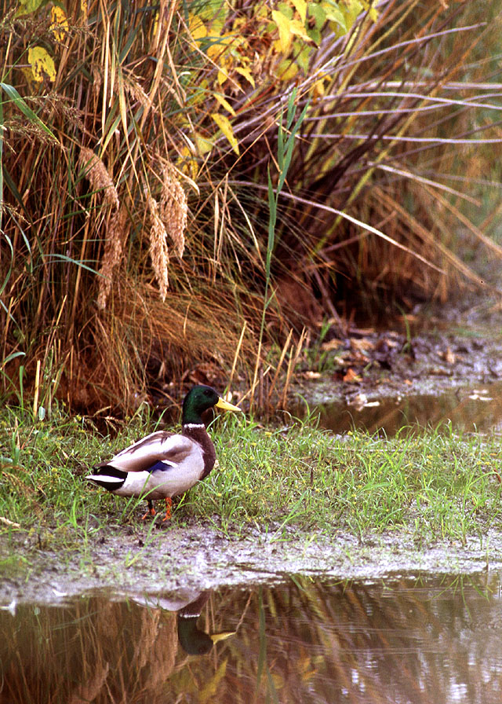
A型流感病毒有甚麼獨特之處?
跨物種間的感染
流感病毒抗原多變性

Slide 32



水鳥是A型流感病毒的天然宿主
銀鷗
短頸野鴨
綠頭鴨
水鳥（aquatic waterfowl）是A型流感病毒的天然宿主，在牠們身上可以分離出大部分的亞型，通常感染的水鳥並不會有症狀。
病毒在水鳥的腸道內繁殖，藉由季節性的遷徙，將流感病毒帶到世界各地，經由糞口傳播的途徑傳染給當地的家禽，或更進一步傳染給當地其它的動物。

Slide 33
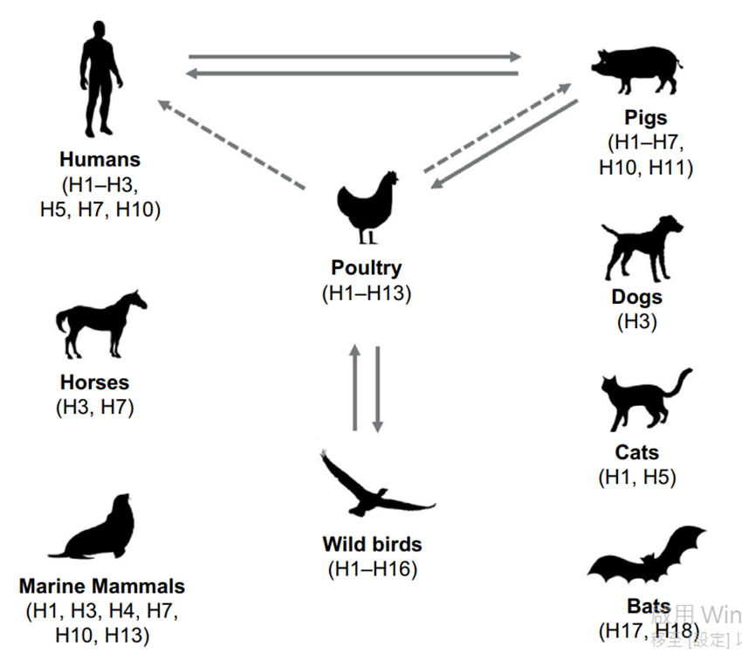
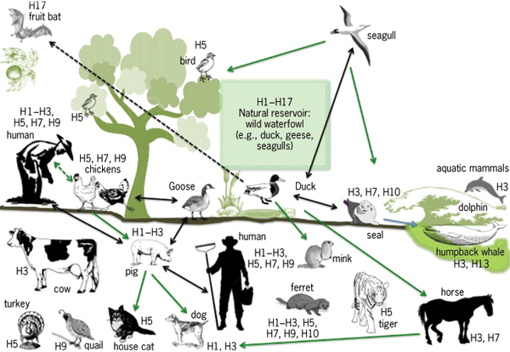
各種A型流感亞型的宿主
A型流感的自然宿主多為野生水禽，經過長時間的候鳥遷徙、攜帶病毒感染不同宿主，並持續在物種間演化，目前多種A型流感病毒亞型已能感染不同物種。
其中最常見的亞型包括H1-H3，主要感染哺乳類動物，以及H5、H7、H9，主要感染家禽。
Infect Drug Resist. 2017 Apr 20;10:121-134.
http://www.accessscience.com/search.aspx?rootID=802694

Slide 34
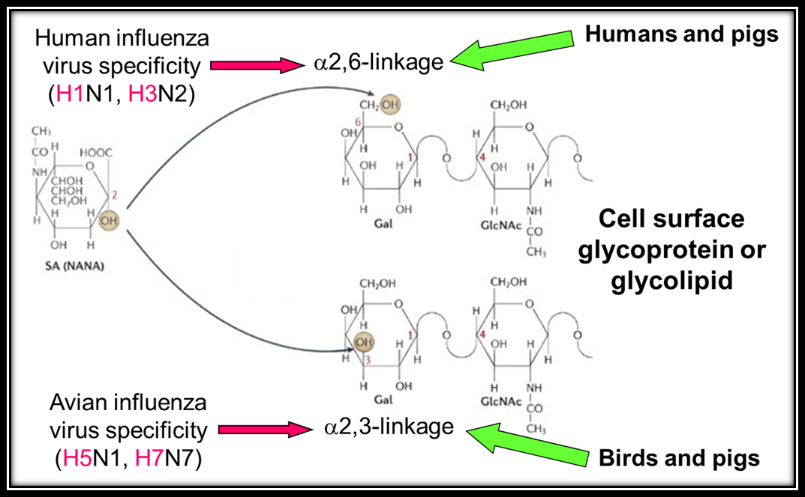
Sialic acid的鍵結決定了流感病毒HA受器的連結
流感病毒藉由血球凝集素HA和宿主細胞的表面接受器唾液酸（sialic acid）結合，進而與細胞膜融合，感染宿主細胞。
--鳥類的呼吸道細胞的唾液酸是以α2,3方式與半乳糖結合（SAα2,3Gal），只能和禽流感病毒結合。
--而人類呼吸道細胞的唾液酸是以α2,6方式和半乳糖結合（SAα2,6Gal），只能和人類流感病毒結合。

Slide 35
18 HA subtypes
11 NA subtypes
α2-6Gal
α2-3Gal
α2-3Gal
α2-6Gal
α2-3Gal
這種病毒與接受器的結合是有專一性的，也是流感病毒感染為何會有物種障礙的原因之一。
α2-6Gal

Slide 36
流感病毒抗原多變性
流感病毒的一個很重要的特徵是具有抗原改變的能力。
抗原的漂變 (Antigenic Drift)
抗原性轉變 (Antigenic Shift)

Slide 37
抗原的漂變 (Antigenic Drift) ：
是在病毒的HA/NA上緩慢、相對上持續的過程，又稱為抗原的連續性變異。
病毒基因複製所累積的點突變（point mutation）所導致，進而產生新的strain。
在A型以及B型流感皆有可能。
因為這新的strain導致之前的抗體無法提供完全的保護力，所以流感疫苗必須時時更新。

Slide 38



抗原的漂變(Antigenic Drift )
RNA
Hemagglutinin
Neuraminidase
Antibodies
Sialic acid
血球凝集素 (Hemagglutinin)
神經胺酸脢 (Neuraminidase)
抗體 (Antibody)

Slide 39
抗原性轉變 (Antigenic Shift) ：
是一較劇烈、突然的過程，又稱為抗原的不連續性變異。
只有A型流感會。
當某一A型流感病毒株帶有在人類已許久沒有流通的HA/NA蛋白時在人類間出現時，便可能造成pandemic。
可能的機轉為：
涉及基因段的互換，例如當不同來源的病毒株同時感染同一宿主時，病毒於複製過程就可能產生基因段互換及重新排列組合（reassortment）。
從動物身上(豬、鳥等)的病毒株直接感染人，而沒有經過基因重組。
某一病毒株從某一動物身上(鳥)經由中間宿主(豬)傳到人身上。

Slide 40


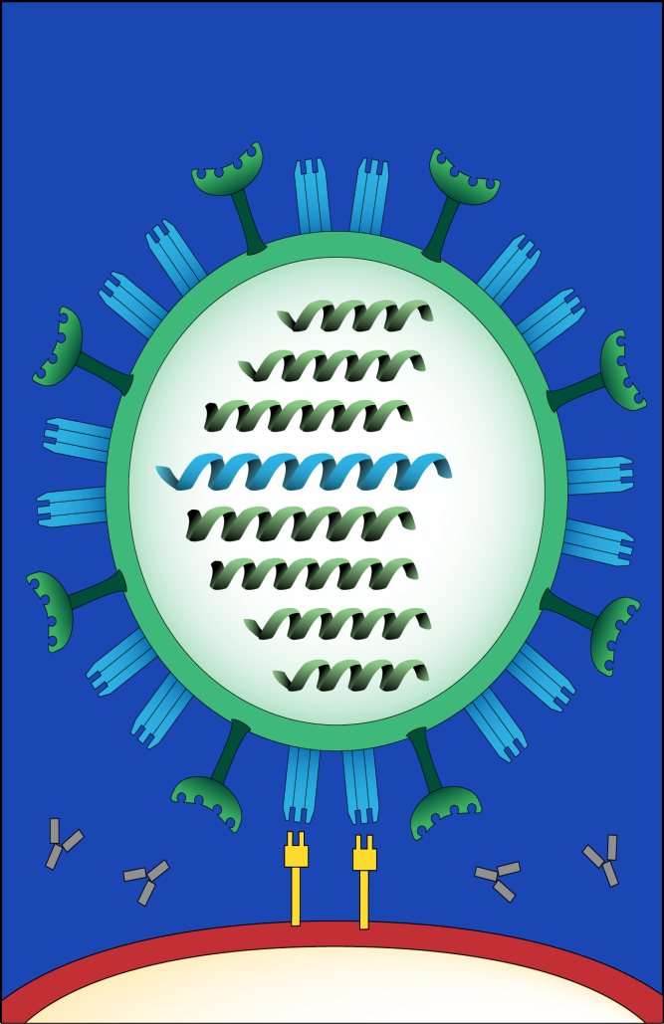

抗原性轉變(Antigenic Shift)

Slide 41
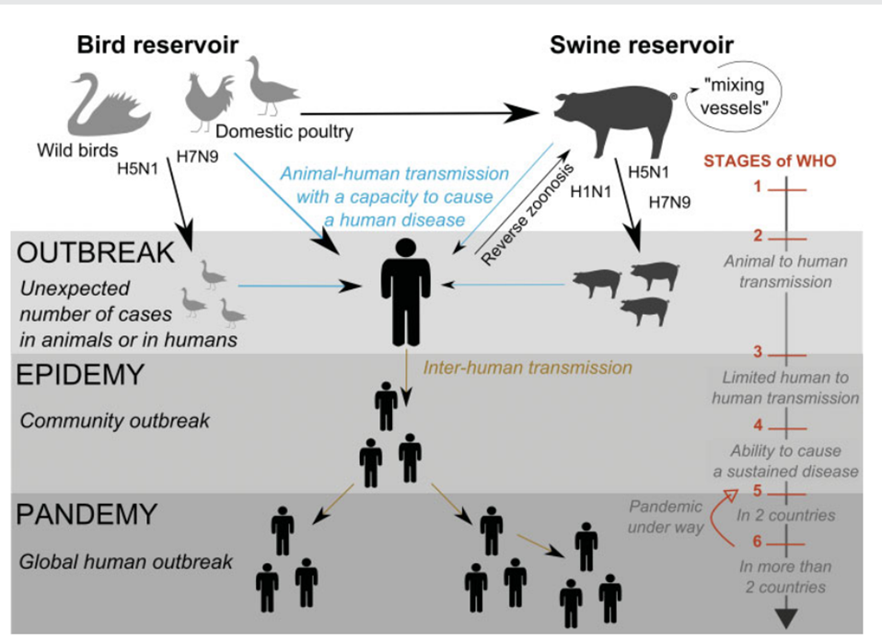
A schematic representation showing major events involved in emergence of an influenza pandemic, from the two major animal reservoirs to the global outbreak in humans
因為豬的呼吸道同時表現出鳥禽與人類的流感受器，所以豬就像是一個 “mixing vessels”，可以讓不同物種間的A型流感產生重組。
Semin Respir Crit Care Med. 2016 Aug;37(4):487-500.

Slide 42
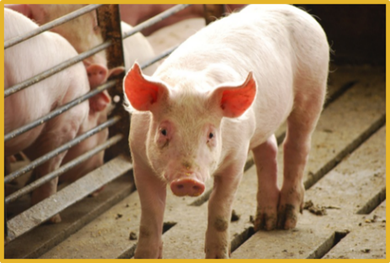
Reassortment

Slide 43
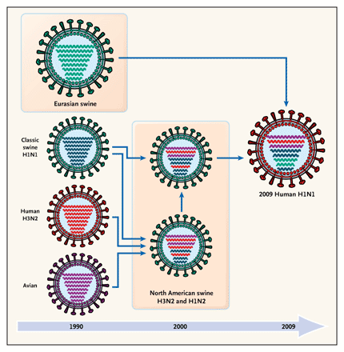
Origin of 2009 pandemic H1N1 influenza strain “quadruple reassortant”
2009的新型流感病毒其祖先可能在1998年之前已存在北美豬群，但僅有少量流傳，且已是人，禽及豬流感病毒基因型三重組株（triple reassortant）
與後來傳入北美豬群的歐亞形似禽型（Avian-like）豬流感病毒發生基因重排組，形成現有可傳播至人類身上且在人際之間大流行的病毒基因組態（gene constellation）
Trifonov et al., NEJM 361:115, 2009

Slide 44
Pandemic Influenza 2009 - Natural history of swine influenza
North American Swine Influenza
(~last 12 years)
Eurasian Swine Influenza
trH3N2
trH3N2
cH1N1
trH1N2
H3N2
cH1N1
trH1N1
PB2 = North Am. Avian
PB1 = Human
PA = North Am. Avian
HA = Human
NP = Classical swine
NA = Human
M = Classical swine
NS = Classical swine
H1N1
PB2 = H3N2 swine
PB1 = H3N2 swine
PA = H3N2 swine
HA = Classical swine
NP = Classical swine
NA = Eurasian swine
M = Eurasian swine
NS = Classical swine
2009 swine-like H1N1
“American flu”

Slide 45
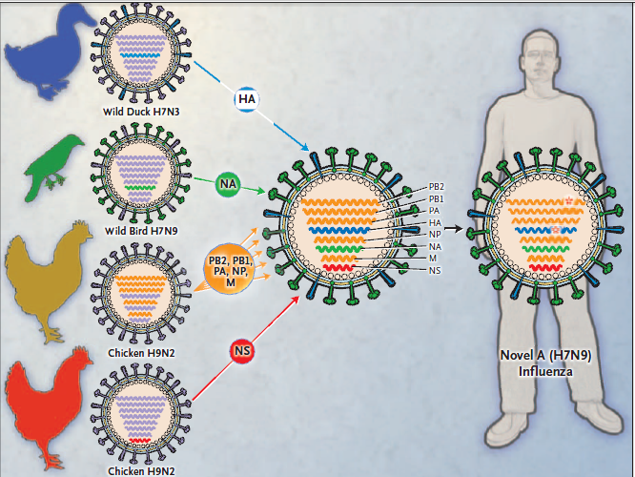
Origin of the novel avian influenza A H7N9 virus
N Engl J Med 2013; 368:2345-2348

Slide 46
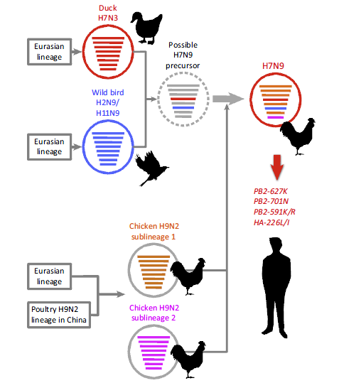
Trends in Microbiology xx (2014) 1–9 1
Notes:
Figure 3. The genesis of avian influenza A (H7N9) influenza virus. The novel H7N9 viruses likely resulted from the reassortment of at least four avian influenza A virus
strains. The hemagglutinin (HA) gene of the H7N9 viruses is closely related to the Eurasian lineage of avian influenza viruses and to that of the avian H7N3 viruses recently
isolated from ducks in Eastern China. The neuraminidase (NA) gene of the novel H7N9 viruses is closely related to that of avian H2N9 and/or H11N9 influenza viruses
isolated from wild migratory birds along the East Asian flyway. The remaining six viral genes likely originated from two distinct subgroups of an H9N2 sub-lineage
circulating in poultry in Eastern China. The virus encircled by the broken line represents a possible precursor of H7N9 avian influenza viruses. Although the H7N9 viruses
currently circulating in birds do not encode determinants of mammalian adaptation (i.e., PB2-627K, PB2-701N, or PB2-591K/R and HA-226L/I), such mutations can arise
during H7N9 virus replication in humans. This figure was created by modification of a figure in

Slide 47
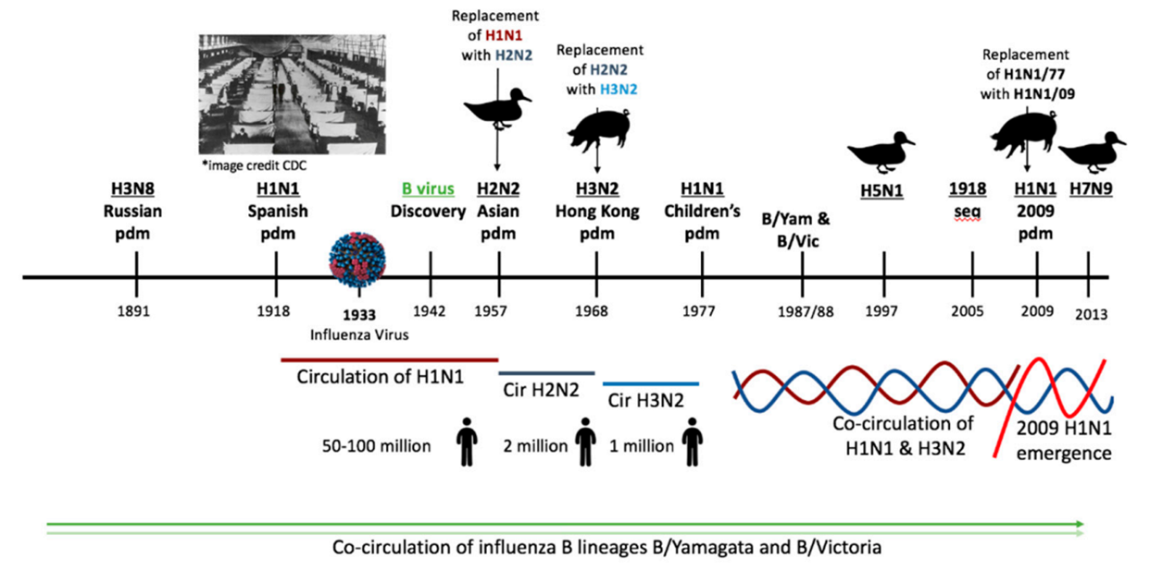
Timeline of the history of influenza virus circulation in humans since 1890s
Viruses. 2019 Jan 30;11(2):122.
Notes:
Figure 3. Timeline of the history of influenza virus circulation in humans since 1890s. The timeline shows the history of influenza virus type A and B circulation since 1890. There have been 6 presumptive pandemics in this time period. The Russian pandemic of ~1891 occurred prior to the discovery of the influenza virus and is known only by historical medical records. Seroarcheology has suggested that this outbreak was caused by an H3N8 virus. In 1918 what was known as the Spanish Influenza Pandemic took place. The H1N1 virus which had caused the pandemic was not definitively identified until lung samples from victims of the pandemic were sequenced in 2005. It is estimated that 50 to 100 million deaths were caused by this virus. H1N1 viruses circulated until 1957 when H1N1 was replaced with an H2N2 pandemic virus during the Asian pandemic. The H2N2 virus was replaced with H3N2 during the 1968 Hong Kong pandemic. In 1977, H1N1 resurfaced and since then, H1N1 and H3N2 have co-circulated. In 2009, the emergence of an H1N1 strain of swine origin replaced the former seasonal H1N1 virus ‘lineage’ which was in circulation from the 1977 lineage. In addition to circulating seasonal influenza viruses, avian virus spillover events also lead to human infection. Major avian virus spillover events occurred in 1997 and 2013 for the influenza A viruses H5N1 and H7N9, respectively. During this time period, influenza B viruses have also co-circulated in humans. *Image credit CDC for the 1918 pandemic and the

Slide 48
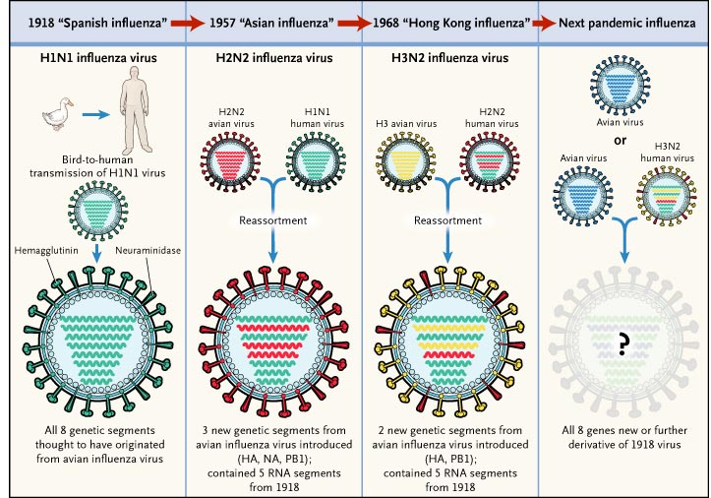

Slide 49
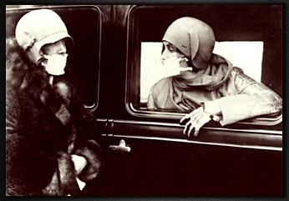
“西班牙流感 ”A(H1N1):1918 -19
全球2千萬人死亡,美國6O萬人死亡 。
©2001 Trish Perl. All Rights Reserved.
JHH Healthcare Epidemiology and Infection Control.
Notes:
The most devastating of the 20th century influenza pandemic was known as the Spanish flu which killed more than 20 million people around the globe between 1918-1920.

Slide 50

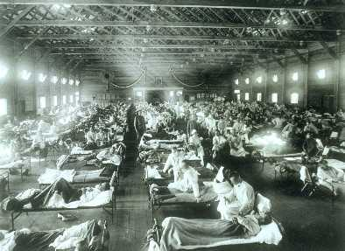

Slide 51

“亞洲流感 ”A(H2N2): 1956- 57
全球l百萬人死亡,美國7萬人死亡。
©2001 Trish Perl. All Rights Reserved.
JHH Healthcare Epidemiology and Infection Control.

Slide 52
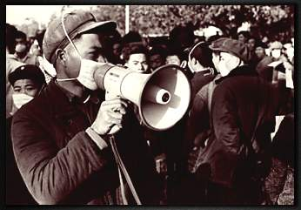
“香港流感 ”A(H3N2):1968 -69
全球1百萬人死亡,美國3萬4千人死亡。
©2001 Trish Perl. All Rights Reserved.
JHH Healthcare Epidemiology and Infection Control.

Slide 53
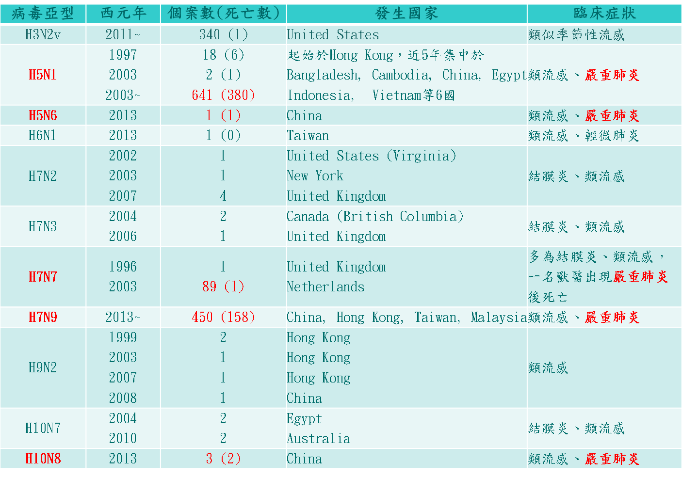
其它曾感染過人類的新型A型流感亞型
不同亞型流感病毒對人類的感染力及所造成疾病嚴重度不相同，目前曾造成人類嚴重疾病的亞型包括於1997年首次出現的H5N1流感，及2013年發現的H7N9流感，其致死率分別約為60%及30%。
另有些流感病毒亞型感染人類後僅引發輕微症狀或無症狀，例如H7N3流感及H9N2流感等。
Reference: http://www.cidrap.umn.edu/infectious-disease-topics/avian-influenza-bird-flu#overview&1-5
Notes:
根據文獻回顧，目前確定曾經感染人類的新型A型流感亞型包括H3N2v、H5N1、H5N6、H6N1、H7N2、H7N3、H7N7、H7N9、H9N2、H10N7、H10N8等，除H3N2v感染來源主要為豬隻以外，其餘亞型均來自禽鳥。本表格整理前述各亞型的發生年份、個案數及死亡數、發生國家及臨床症狀，其中曾導致病患併發嚴重肺炎而死亡的亞型包括H5N1、H5N6、H7N7、H7N9及H10N8，H3N2v雖曾造成一位具慢性病史的年長病患死亡，不過整體來說各項疾病特性類似季節性流感。

Slide 54
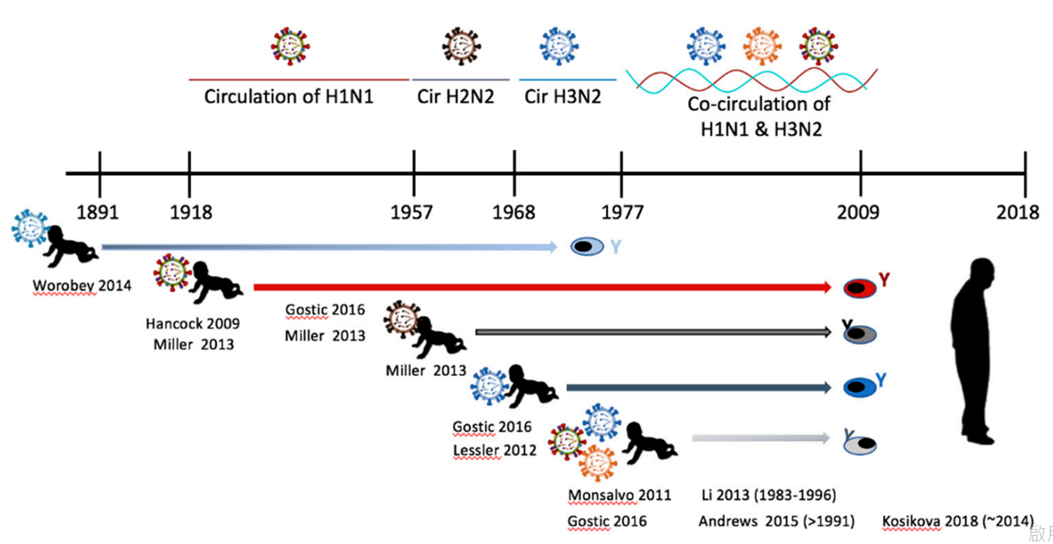
Influenza immune imprinting and the history of circulating influenza viruses
Unlike older children and adults, the infant immune system has fewer antigen-presenting cells and soluble immune factors.
Paradoxically, we know that a person’s first infection with the influenza virus during infancy or childhood leads to the establishment of life-long immunity toward that particular virus strain. This is called influenza imprinting (流感的印記)
Viruses. 2019 Jan 30;11(2):122.
Notes:
Figure 4. Influenza immune imprinting and the history of circulating influenza viruses. The timeline illustrates the relationship between virus circulation and influenza virus immune imprinting at infancy. Several published studies have shown that antibodies reactive toward the imprinting virus can last throughout the host’s lifetime. Human studies investigating imprinting serology, epidemiology, or cell reactivity are noted in the figure for the time period of imprinting. The author’s last name and publication date are given. The date in parentheses refers to study subjects’ date of birth if it is not easily deduced fro

Slide 55
大綱
在COVID-19疫情下，流感的疫情如何呢?
在COVID-19疫情下，其它呼吸道病毒的疫情如何呢?
放寬non-pharmaceutical interventions管制後，呼吸道感染的疫情可能會如何呢?
為什麼我們要來認識流感的威脅呢?
流感的症狀、併發症與其它病原菌的共同感染
抗藥性流感病毒株

Slide 56

病毒感染的潛伏期
Lancet Infect Dis 2009;9:291-300

Slide 57

流感的症狀

Slide 58
流感,一般感冒,及H5N1流感比較表
項目 | 流感 | 一般感冒 | H5N1流感
至病原 | 流感病毒,可分為A(H1N1及H3N2),B,C三型 | 大約有200多種病毒可引起,常見的由鼻病毒,副流感病毒,呼吸道融合性病毒,腺病毒等 | 流感病毒(H5N1)
臨床症狀
發燒 | 有,高燒,約可持續3天 | 少發燒,僅體溫些微升高 | 有,高燒
喉嚨痛 | 明顯的喉嚨痛 | 較不嚴重 | 常見
頭痛 | 通常伴隨著嚴重頭痛 | 偶而輕微頭痛 | 常見
全身痠痛及疲 倦 | 全身肌肉酸痛,關節痛,會有明顯且持續的倦怠感與全身無力 | 較輕微或少見 | 常見
肌肉痛 | 少部分幼童會有小腿肌肉酸痛 |  | 肌肉痛
打噴嚏與流鼻 水 | 症狀出現之初1~2天內會出現打噴嚏,流鼻水 | 通常會有打噴嚏與鼻塞 | 常見
咳嗽 | 出現在症狀開始後1~2天之內 |  | 常見
腹瀉 | 少見 | 無或少 | 常見
其它 | 寒顫 |  | 肺炎,呼吸困難,呼吸衰竭,多重器官衰竭及死亡
潛伏期 | 約1~4天 | 約1天 | 2~8天

Slide 59
流感,一般感冒,及H5N1流感比較表
項目 | 流感 | 一般感冒 | H5N1流感
高危險族群 | 所有年齡族群 | 所有年齡族群 | 農牧業,屠宰業,醫療照護業,相關研究實驗室
傳染途徑 | 飛沫傳染;接觸傳染 | 飛沫傳染;接觸傳染 | 1.禽傳人:接觸H5N1流感病患肢動物或其排遺,至吸入或接觸掩鼻黏膜 2.有限人傳人:與病例密切接觸
病程 | 1~2週 | 短期間可復原 | 自發病死亡介於1~30天(中位數9天)
治療 | 依照醫師處方給予抗病毒藥物治療及支持性療法 | 感冒多半可自癒,支持性療法 | 48小時內給予抗病毒藥物
預後 | 佳 | 佳 | 部份轉為病毒性肺炎,嚴重時會死亡,致死率高
併發症 | 肺炎,心肌炎,腦病變,腦炎,雷氏症候群等 | 較少出現合併症 | 肺炎,腦炎,血球吞噬症候群
預防方法 | 有疫苗 | 無疫苗 | 無疫苗

Slide 60

Am Fam Physician. 2019;100(12):751-758

Slide 61


The frequency of influenza and bacterial coinfection
Streptococcus pneumoniae and Staphylococccus aureus were the most common pathogens accounting for 35% (95% CI, 14%–56%) and 28% (95% CI, 16%–40%) of identified coinfecting bacteria, respectively
Influenza Other Respir Viruses. 2016 Sep;10(5):394-403.

Slide 63
病毒性肺炎常見的電腦斷層表現
The imaging findings seen in patients with H1N1 infection include:
Consolidations
Ground-glass opacities
Interlobular septal thickening
Small nodules
Findings suggestive of small airways disease
American Journal of Roentgenology. 2011;196: W723-W728

Slide 64



32-year-old man with H1N1 pneumonia.
A, Chest radiograph shows normal lungs.
B, CT image obtained on same day as A shows mild ground-glass opacity in both lungs that predominates in lower lobes.
44-year-old man with H1N1 pneumonia.
A and B, CT images at carina level (A) and main bronchi level (B) show bilateral round consolidations with peribronchovascular distribution. Also seen is small bilateral pleural effusion (arrowheads).
35-year-old woman with H1N1 pneumonia.
A–C, Axial CT image (A), coronal reformatted image (B), and sagittal reformatted image (
American Journal of Roentgenology. 2011;196: W723-W728

Slide 65


The frequency of influenza and IPA coinfection
J Fungi (Basel). 2022 Apr 22;8(5):428.

Slide 66



Forest plots of risk factors for the development of invasive pulmonary aspergillosis
Lancet Respir Med. 2018 Oct;6(10):782-792
Clin Infect Dis. 2020 Oct 23;71(7):1764-1767.

Slide 67

Intensive Care Med. 2020 Aug;46(8):1524-1535.

Slide 68



Intensive Care Med. 2020 Aug;46(8):1524-1535.

Slide 69
大綱
在COVID-19疫情下，流感的疫情如何呢?
在COVID-19疫情下，其它呼吸道病毒的疫情如何呢?
放寬non-pharmaceutical interventions管制後，呼吸道感染的疫情可能會如何呢?
為什麼我們要來認識流感的威脅呢?
流感的症狀、併發症與其它病原菌的共同感染
抗藥性流感病毒株

Slide 70

Amantadine與Rimantadine均可作用於貫穿於病毒外膜上由M2 protein組成的離子通道 (ion channel)。
當病毒進入細胞內時，氫離子會進入病毒的M2 protein離子通道，並引發病毒複製之後續機序。
一旦Amantadine與Rimantadine進入M2 protein 離子通道，則將阻斷氫離子進入病毒的M2 protein離子通道，抑制病毒於細胞內複製。
N Engl J Med. 2006 Feb 23;354(8):785-8.
Notes:
Mechanism of Action of and Development of Resistance to M2 Inhibitors. In the absence of amantadine, the proton channel mediates an influx of H+ ions into the infecting virion early in the viral replication cycle, which facilitates the dissociation of the ribonucleoproteins from the virion interior and allows them to be released into the cytoplasm and transported into the cell nucleus. In highly pathogenic avian viruses (H5 and H7), the M2-proton channel protects the hemagglutinin from acid-induced inactivation in the trans-Golgi network during transport to the cell surface. In the presence of amantadine, the channel is blocked and replication is inhibited. The serine at position 31 lies partially in the protein–protein interface and partially in the channel (see inset). Replacement of serine by a larger asparagine leads to the loss of amantadine binding and the restoration of channel function. Depending on the particular amino acid, other mutations at position 26, 27, 30, or 34 may inhibit amantadine binding or allow binding without the loss of ion-channel function. Inset courtesy of Rupert Russell, Phillip Spearpoint, and Alan Hay, National Institute for Medical Research, London

Slide 71
M2 protein inhibitor
藥名 | 金剛烷 (Amantadine) | 甲基金剛烷 (Rimantadine)
作用機轉 (Mechanism) | 干擾A型流感病毒複製 對B型流感病毒無效 | 干擾A型流感病毒複製 對B型流感病毒無效
效力 (Efficacy) | 48小時內投藥可降低病情嚴重度及縮短病程 | 48小時內投藥可降低病情嚴重度及縮短病程
適應症 (Indications) | 兒童及成人 | 成人

Slide 72

M2 protein inhibitor 的限制：
只對A型流感有效，因B型流感病毒沒有M2 protein 。
副作用發生頻率高，包括中樞神經副作用(CNS side effect，焦慮，無法集中)及腸胃道副作用等。
在現行流行的A型流感廣泛出現抗藥性。
現在已沒再用來治療流感了!!
1, CDC MMWR April 20, 2001
2, Antimicrob Agents Chemother 1991; 35:1741~7
3, Arch Intern Med 1995; 155:533~7

Slide 73

對amantadine產生抗藥的病毒株:
在治療過程中很快就會出現，甚至在治療後的2-3天就會出現。
這樣的突變在基因上是穩定的，在實驗室中經過好幾代的傳播，依然可以保持其表現型。
儘管沒有選擇性壓力的存在，high-level抗藥性依然持續在circulating influenza A中存在
在被感染的家庭或是養護機構的研究可以發現這個突變菌株是可以傳播的，且造成典型的流感症狀。
Curr Top Microbiol Immunol. 1992;176:119-30
Notes:
Amantadine- and rimantadine-resistant viruses have been recovered from approximately 30% of patients treated for acute H3N2 subtype influenza and less often from their close contacts receiving drug prophylaxis. The limited data suggest that resistant viruses can emerge rapidly during drug therapy, as early as 2-3 days into treatment. These viruses retain their resistance phenotype during multiple passages in the laboratory and appear to be genetically stable in this regard. Studies in families and in nursing homes indicate that resistant isolates appear to be transmissible from treated patients and cause typical influenza in contacts receiving drug prophylaxis. It is unknown whether resistant human viruses are capable of competing with wild-type ones during multiple cycles of infection in the absence of the drug. These viruses appear to be pathogenic, and no evidence indicates that they differ from wild-type strains. Thus, these viruses clearly possess the biologic properties that are associated with clinically important drug resistance. However, limited information is available to assess their actual impact. It is unknown what degree of selective drug pressure would be required to cause substantial transmission of resistant viruses during community outbreaks. Natural selection of antigenic variants and disappearance of previous variants may prevent the emergence of viruses that have been altered in the genes coding both for the surface glycoproteins and for the M2 protein. However, the emergence of drug-resistant influenza viruses appears to pose potential clinical problems in certain epidemiologic situations involving close contact with treated patients.

Slide 74

.
N Engl J Med. 2006 Feb 23;354(8):785-8.

Slide 75
神經胺酸脢抑制劑
和M2抑制劑比起來, 副作用少相當多。
和M2抑制劑比起來較不易造成抗藥性菌株。
對所有的病毒株都有效, 這在大流型疫情時非常重要。
因為流感病毒株的複製在疾病開始後的24至72小時內達到最高點，因此作用在病毒複製期的身經安酶抑制劑必須在疾病開始盡量越早給藥越好
The New England Journal of Medicine 2005, 353:1363-1373

Slide 76

神經氨脢抑制劑的作用機轉
N Engl J Med 2005;353:1363-73.
Notes:
Panel A shows the action of neuraminidase in the continued replication of virions in influenza infection. The replication is
blocked by neuraminidase inhibitors (Panel B), which prevent virions from being released from the surface of infected cells

Slide 77



Antiviral Medications Recommended for Treatment and Chemoprophylaxis of Influenza – U.S. CDC
Antiviral Agent |  | Use | Recommended For | Not Recommended for Use in | Adverse Events
Oral Oseltamivir | Influenza A and B | Treatment | Any age¹ | N/A | Adverse events: nausea, vomiting. Post marketing reports of serious skin reactions and sporadic, transient neuropsychiatric events (self-injury or delirium; mainly reported among Japanese adolescents and adults).
 |  | Chemo- prophylaxis | 3 months and older¹ | N/A
Inhaled Zanamivir | Influenza A and B | Treatment | 7 yrs and older | people with underlying respiratory disease (e.g., asthma, COPD)² | Allergic reactions: oropharyngeal or facial edema. Adverse events: diarrhea, nausea, sinusitis, nasal signs and symptoms, bronchitis, cough, headache, dizziness, and ear, nose and throat infections.
 |  | Chemo- prophylaxis | 5 yrs and older | people with underlying respiratory disease (e.g., asthma, COPD)²
Intravenous Peramivir | Influenza A and B³ | Treatment | 2 yrs and older | N/A | Adverse events: diarrhea. Post marketing reports of serious skin reactions and sporadic, transient neuropsychiatric events (self-injury or delirium; mainly reported among Japanese adolescents and adults).
 |  | Chemo- prophylaxis | N/A | N/A
N/A = not applicable, COPD = chronic obstructive pulmonary disease
US CDC, http://www.cdc.gov/flu/professionals/antivirals/summary-clinicians.htm
Notes:
¹ Oral oseltamivir is approved by the FDA for treatment of acute uncomplicated influenza in persons 14 days and older, and for chemoprophylaxis in persons 1 year and older. Although not part of the FDA-approved indications, use of oral oseltamivir for treatment of influenza in infants less than 14 days old, and for chemoprophylaxis in infants 3 months to 1 year of age, is recommended by the CDC and the American Academy of Pediatrics. If a child is younger than 3 months old, use of oseltamivir for chemoprophylaxis is not recommended unless the situation is judged critical due to limited data in this age group.
² Relenza is contraindicated in patients with history of allergy to milk protein.
³ Peramivir efficacy is based on clinical trials in which the predominant influenza virus type was influenza A; a limited number of subjects infected with influenza B virus were enrolled.

Slide 78

四種神經胺酶抑制劑與涎酸(sialic acid)的結構比較
因為結構不完全相同，彼此間不見得會有交互抗藥性
Current Opinion in Virology 2014, 8:22–29
Notes:
The neuraminidase inhibitors (NAIs) are sialic acid analogues that have
additional features which enable enhanced binding to the enzymatic site. The presence or absence of key structural features of the NAIs provides
insight into how they bind to the enzymatic site and the effect that amino acid substitutions can have on drug binding. Oseltamivir and peramivir both
share the hydrophobic pentyl ether group which, in the event of a H275Y NA mutation, means that both drugs demonstrate reduced binding to the
enzymatic site of N1 neuraminidases. *Zanamivir and laninamivir share very similar structures, except that the glycerol side chain is modified by the
addition of an alkyl group in laninamivir.
Although all four NAIs are based on the structure of sialic acid, there are some important differences (Figure 1), such that there is little cross resistance between oseltamivir and zanamivir, that is, resistance against osel-tamivir generally does not alter zanamivir sensitivity. However, some cross resistance is observed between zanamivir and laninamivir, and between oseltamivir and peramivir depending on the location of the amino acid mutation in the NA active site.

Slide 79

Eur J Clin Microbiol Infect Dis. 2020 Jul;39(7):1201-1208.

Slide 80

Semin Respir Crit Care Med. 2011 Aug;32(4):409-22.
Notes:
Influenza viruses are major human pathogens with a global distribution, accounting for more than 500,000 annual deaths worldwide and with considerable impact on the quality of life and productivity of the society. Due to the limited efficacy of vaccination, antiviral drugs constitute a complementary approach in the control and prevention of influenza infections and thus play an important role in the management of influenza outbreaks and pandemics. Currently, adamantanes and neuraminidase inhibitors (NAIs) are the only two classes of anti-influenza agents approved for clinical use. However, the worldwide emergence and high prevalence of adamantane-resistant virus variants has discouraged the use of the former drugs. NAIs have proved to be very effective against influenza A and B viruses. Nevertheless, oseltamivir-resistant strains have also been reported quite frequently, as in the case of seasonal H1N1 viruses that circulated between 2007 and 2009. Indeed, the emergence of drug-resistant virus variants is always a matter of concern because it could significantly compromise the usefulness of such intervention. This highlights the need for continuous monitoring of resistance markers, as well as the development of new anti-influenza drugs and combination therapies.

