Slide 1
流感臨床診斷與檢驗
成大醫院 感染科
羅景霳

Slide 2
流感季節時，
哪個診斷工具CP最高

Slide 3
哪個診斷工具CP最高
快篩
PCR
血清抗體
我有一個大膽的想法

Slide 4
哪個診斷工具CP最高
快篩
PCR
血清抗體
我有一個大膽的想法

Slide 5
Clinical Diagnosis
病史詢問

Slide 6
Clinical Diagnosis
病史詢問
80～90%

Slide 7

病史詢問
80～90%準確率

Slide 8
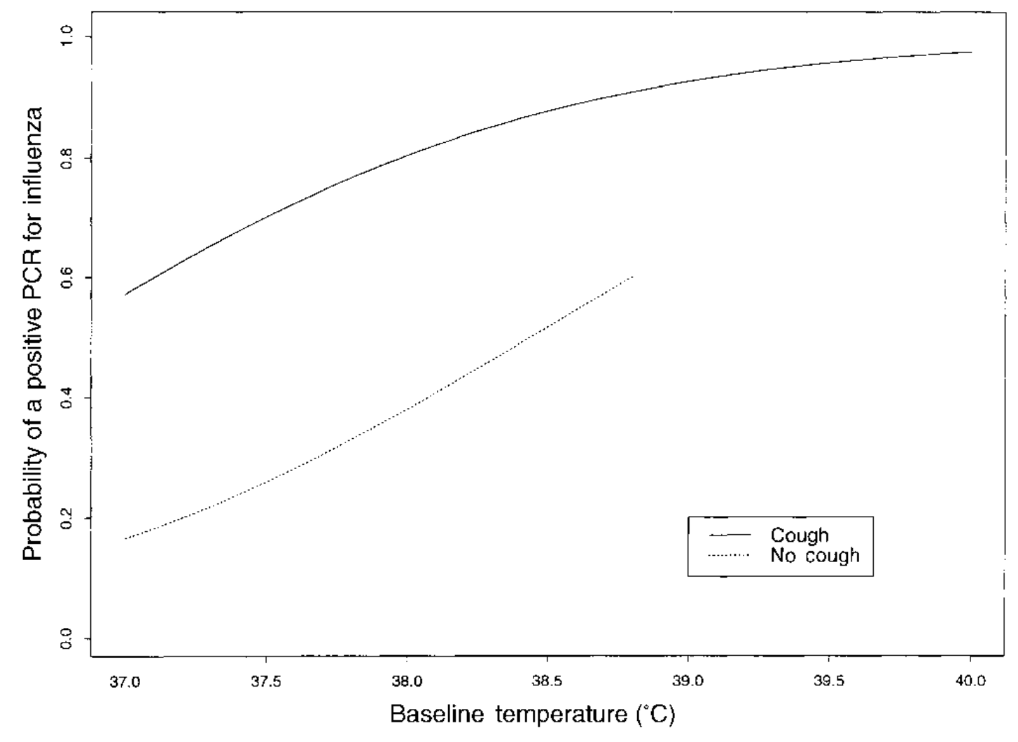
病史詢問與流感診斷

Slide 9
病史詢問與流感診斷
核
酸
陽
性
預
測
值

Slide 10
病史詢問與流感診斷
核
酸
陽
性
預
測
值
發燒
咳嗽

Slide 11
流感臨床診斷與檢驗
臨床表現
診斷工具
鑑別診斷

Slide 12
流感臨床診斷與檢驗
臨床表現
診斷工具
鑑別診斷

Slide 13
流感臨床診斷與檢驗
臨床表現
診斷工具
鑑別診斷

Slide 14
流感臨床診斷與檢驗
臨床表現
診斷工具
鑑別診斷

Slide 15
流感臨床診斷與檢驗
臨床表現
診斷工具
鑑別診斷

Slide 16
流感臨床表現
Incubation
Uncomplicated
Complicated

Slide 17
流感臨床表現
Uncomplicated
Complication
Complicated

Slide 18
Uncomplicated influenza
Clinical course
  Incubation period
  Disease period

Slide 19
Uncomplicated influenza
Onset
Incubation
Disease period

Slide 20
Uncomplicated influenza
Onset
Incubation
Disease period

Slide 21

Incubation period

Slide 22
Incubation period
2天
(1～4天)

Slide 23
Uncomplicated influenza
Onset
Incubation
Disease period

Slide 24
講到流感症狀
你會想到什麼?

Slide 25
Symptom
Uncomplicated influenza
Systemic symptom
Respiratory symptom

Slide 26
Symptom
Uncomplicated influenza
Systemic symptom
Respiratory symptom

Slide 27
Systemic symptom
Uncomplicated influenza
Fever/Chillness
Myalgia/Headache
Malaise/Anorexia

Slide 28
Systemic symptom
Uncomplicated influenza
Fever
  Abrupt onset

Slide 29
Systemic symptom
Uncomplicated influenza
Fever
  Abrupt onset
  知道明確時間

Slide 30
Systemic symptom
Uncomplicated influenza
Fever
  37.8～40.0ºC

Slide 31
Systemic symptom
Uncomplicated influenza
Fever
  37.8～41.1ºC

Slide 32
Systemic symptom
Uncomplicated influenza
Fever
  Highest on D1

Slide 33
Systemic symptom
Uncomplicated influenza
Fever
  Highest on D1
  0.3~0.6ºC lower afterward

Slide 34
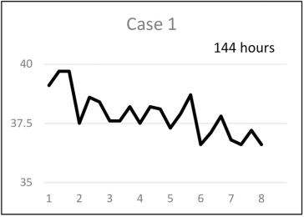
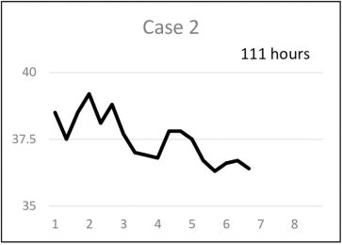
Fever curve of influenza
﻿PLoS ONE 14(11): e0224683

Slide 35
Systemic symptom
Uncomplicated influenza
Fever duration
  3 days

Slide 36
Systemic symptom
Uncomplicated influenza
Fever duration
  3 days (4~8 days)

Slide 37
Systemic symptom
Uncomplicated influenza
Myalgia/Headache

Slide 38
Systemic symptom
Uncomplicated influenza
Myalgia/Headache
  Most troublesome

Slide 39
Systemic symptom
Uncomplicated influenza
Myalgia/Headache
  Most troublesome
  Relate to height of fever

Slide 40
Systemic symptom
Uncomplicated influenza
Myalgia
  Extremities
  Long muscle of back

Slide 41
Systemic symptom
Uncomplicated influenza
Myalgia
  Extremities
  Long muscle of back
  Eye muscle

Slide 42
Systemic symptom
Uncomplicated influenza
Myalgia
  Extremities
  Long muscle of back
  Eye muscle
    pain while gazing laterally

Slide 43
Symptom
Uncomplicated influenza
Systemic symptom
Respiratory symptom

Slide 44
Respiratory symptom
Uncomplicated influenza
Dry cough
Severe pharyngeal pain
Nasal obstruction and discomfort

Slide 45
Respiratory symptom
Uncomplicated influenza
Dry cough
Severe pharyngeal pain
Nasal obstruction and discomfort

Slide 46
Respiratory symptom
Uncomplicated influenza
After systemic symptom diminish
  Recurrent cough
  Hoarseness
  Dry or sore throat

Slide 47
Respiratory symptom
Uncomplicated influenza
After systemic symptom diminish
  Recurrent cough
  Hoarseness
  Dry or sore throat
不是變嚴重

Slide 48
Typical Symptom
Uncomplicated influenza
Systemic symptom
Respiratory symptom

Slide 49
Atypical Symptom
Uncomplicated influenza

Slide 50
Atypical Symptom
Uncomplicated influenza
Age > 65 years old
Immunocompromised

Slide 51
Atypical Symptom
Uncomplicated influenza
No fever
Milder systemic symptom

Slide 52
Atypical Symptom
Uncomplicated influenza
No fever
Milder systemic symptom
Generalized symptom

Slide 53
Atypical Symptom
Uncomplicated influenza
No fever
Milder systemic symptom
Generalized symptom
  Anorexia/Malaise/Weakness
  Dizziness

Slide 54
Atypical Symptom
Uncomplicated influenza
Older adults

Slide 55
Atypical Symptom
Uncomplicated influenza
Older adults
  Altered mental status

Slide 56
Uncomplicated influenza
Onset
Incubation
Disease period
2天
3天 +數天

Slide 57
沒有在天天過年

Slide 58
流感臨床表現
Uncomplicated
Complication
Complicated

Slide 59
Risk of complication

Slide 60
Risk of complication
Children < 5 years old
  Esp. < 2 years old
Adult ≥ 65 years old
Pregnant women / 2 weeks postpartum
Residents of nursing homes and long-term care facilities
People with medical condition

Slide 61
Risk of complication
Medical condition

Slide 62
Risk of complication
Medical condition
Neurological and neurodevelopmental conditions
Asthma
Chronic lung disease
Heart disease
Endocrine disorders
Kidney disorder
Liver disorders
Blood disorder
Metabolic disorder
Weakened immune system
BMI ≥ 40
Children<19 y/o under long-term ASA

Slide 63
Complication of influenza
Respiratory
Extrapulmonary

Slide 64
Complication of influenza
Respiratory
Extrapulmonary

Slide 65
Pneumonia

Slide 66
Symptom of pneumonia
Cough with dyspnea
Tachypnea
Hypoxia
Fever

Slide 67
Types of pneumonia
Primary influenza viral pneumonia
Secondary bacterial pneumonia
Mixed viral and bacterial pneumonia

Slide 68
Types of pneumonia
Primary influenza viral pneumonia
  Persistent fever and symptom after 3-5 days of symptom

Slide 69
Types of pneumonia
Secondary bacterial pneumonia
  Improvement of influenza symptom
  Relapse of fever and cough with purulent sputum

Slide 70
Types of pneumonia
Mixed viral and bacterial pneumonia
  Gradual progression
  or Transient improvement followed by worsening

Slide 71
Complication of influenza
Respiratory
Extrapulmonary

Slide 72
Extrapulmonary complication
Cardiac
Central nervous system
Myositis and rhabdomyolysis
Multisystem organ failure
Concomitant infection

Slide 73
Extrapulmonary complication
Cardiac
  Myocardial infarction
  Myocarditis/Pericarditis

Slide 74
Extrapulmonary complication
Central nervous system
  Guillain-Barre syndrome

Slide 75
Extrapulmonary complication
Central nervous system
  Guillain-Barre syndrome
    Incidence after influenza
      90 days: 7.35 (95% CI: 4.36-12.38)
      30 days: 16.64 (95% CI: 9.37-29.54)

Slide 76
臨床表現
在流感流行期，臨床診斷的正確率高
Uncomplicated influenza中，全身症狀，如發燒和肌肉痠痛等，是流感的特色
Influenza complication中，肺炎是最常見的併發症，如果病程超出預期，要特別注意

Slide 77
流感臨床診斷與檢驗
臨床表現
診斷工具
鑑別診斷

Slide 78
診斷工具的目的
Symptom may be typical
Physical examination few finding
Laboratory test nonspecific
Image generally normal

Slide 79
診斷工具
Whom to test
What to test
How to test

Slide 80
診斷工具
Whom to test
What to test
How to test

Slide 81
Whom to test
原則

Slide 82
什麼狀況下
你會想要做流感檢驗

Slide 83
Whom to test?
原則
病患免疫不好
病人年齡超過65歲
決定是否治療
想要決定病人的下一步處置

Slide 84
Whom to test
原則
If result will influence management
Public health activity

Slide 85
Whom to test
原則
If result will influence management
  Antiviral or antimicrobial agents
  Further diagnostic evaluation
  Prophylaxis for high risk contacts
  Infection control intervention

Slide 86
Whom to test
原則
Public health activity
  Interventions for outbreak management

Slide 87
Whom to test
不同背景
Influenza is circulating
Influenza is not circulation

Slide 88
Influenza not circulating
Whom

Slide 89
Influenza not circulating
Whom
九月～隔年四月

Slide 90
Influenza not circulating
Whom
九月～隔年四月
十一月～隔年三月

Slide 91
Influenza is circulating
Whom
Present influenza-like illness
  Immunocompromised
  high risk of complication
Acute respiratory symptoms
  Exacerbation of chronic medical condition
  Influenza complication
Hospitalized patients
  Acute respiratory symptoms
  Exacerbations of chronic medical condition

Slide 92
流行期間
有風險/症狀惡化可檢驗

Slide 93
Whom to test
不同背景
Influenza is circulating
Influenza is not circulation

Slide 94
Influenza not circulating
Whom
Relevant epidemiologic exposure

Slide 95
Influenza not circulating
Whom
Relevant epidemiologic exposure
  Exposure to person with influenza
  Outbreak of respiratory illness of uncertain cause
  Recent travel in an area with influenza activity

Slide 96
非流行期間
要有曝觸才要驗

Slide 97
診斷工具
Whom to test
What to test
How to test

Slide 98
What to test
Molecular assay
Antigen detection assay
Others

Slide 99
Molecular assay
What to test
High sensitivity
High specificity

Slide 100
Molecular assay
What to test
Conventional RT-PCR
Multiplex RT-PCR
Rapid molecular tests

Slide 101
Molecular assay
What to test
Conventional RT-PCR
Multiplex RT-PCR
Rapid molecular tests

Slide 102
Conventional RT-PCR
Molecule
Distinguish influenza A and B
Influenza A subtype

Slide 103
Conventional RT-PCR
Molecule
Distinguish influenza A and B
Influenza A subtype
Turnaround time: 1-8 hours

Slide 104
Multiplex RT-PCR
Molecule
Several pathogens detection

Slide 105
Multiplex RT-PCR
Molecule
Several pathogens detection
For
  Immunocompromised
  Requiring hospitalization
  During period of influenza and COVID-19

Slide 106
Filmarray respiratory panel
Adenovirus
Human Rhinovirus/ Enterovirus
Influenza virus
Respiratory syncytial virus
Parainfluenza
Human metapneuovirus
Coronavirus
  Severe acute respiratory syndrome coronavirus 2
Chlamydia pneumoniae
Bordetella pertussis
Bordetella parapertussis
Mycoplasma pneumoniae

Slide 107
Rapid molecular tests
Molecule
Distinguish influenza A and B
No influenza A subtype

Slide 108
Rapid molecular tests
Molecule
Distinguish influenza A and B
No influenza A subtype
Turnaround time: 15~30 min

Slide 109
What to test
Molecular assay
Antigen detection assay
Others

Slide 110
Antigen detection assay
Low to moderate sensitivity
High specificity

Slide 111
Antigen detection assay
Low to moderate sensitivity 50~70%
High specificity

Slide 112
Antigen detection assay
Interpret with caution
  False negative result are common
  Not used for hospitalized

Slide 113
Antigen detection assay
Molecular test recheck

Slide 114
Antigen detection assay
Molecular test recheck
  Negative Ag in high community influenza, and indication for confirmation
  Positive Ag in low community influenza
  Recent exposure to pigs or poultry

Slide 115
What to test
Molecular assay
Antigen detection assay
Others

Slide 116
Others
Viral culture
Serological tests

Slide 117
Others
Viral culture: public surveillance
Serological tests: not routine test

Slide 118
診斷工具
Whom to test
What to test
How to test

Slide 119
How to test
檢測時間點
採哪裡
用什麼採檢

Slide 120
檢測時間點
Within four days of symptom onset

Slide 121
採哪裡
首選為Nasopharynx

Slide 122
採哪裡
首選為Nasopharynx
其次是Nasal加上Throat swab

Slide 123
採哪裡
首選為Nasopharynx
其次是Nasal加上Throat swab
  若非要選一個，就選nasal swab

Slide 124
採哪裡
For ventilated patients with negative upper respiratory tract

Slide 125
採哪裡
For ventilated patients with negative upper respiratory tract
  Endotracheal aspirate
  Bronchoalveolar lavage fluid

Slide 126
採哪裡
For ventilated patients with negative upper respiratory tract
  Endotracheal aspirate
  Bronchoalveolar lavage fluid
Greater and prolonged respiration in lower respiratory tract

Slide 127
用什麼採

Slide 128
用什麼採
Flocked swab

Slide 129
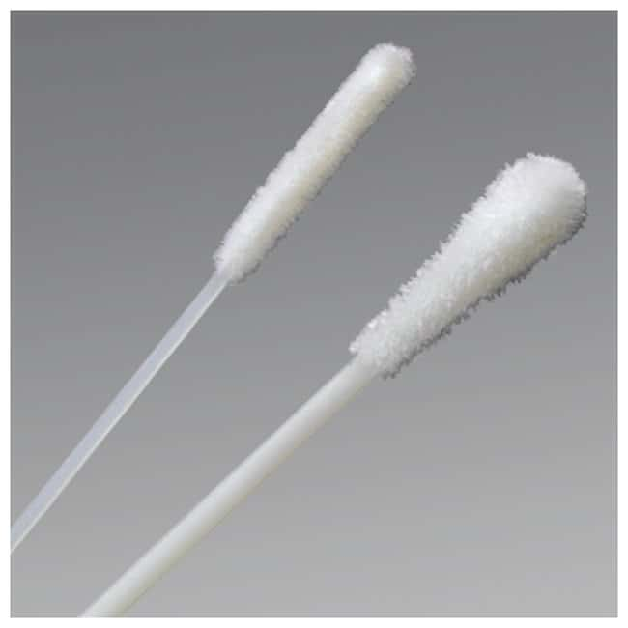
用什麼採
Flocked swab
https://www.thermofisher.com/order/catalog/product/R12566

Slide 130
診斷工具
當檢驗結果會影響後續決策或是要進行流病調查時，才需要進行流感的檢測
流感診斷以核酸檢測為原則，若是用抗原檢測，則需要小心判讀
在病程早期進行檢測的陽性率較高，最好是取鼻咽的檢體

Slide 131
流感臨床診斷與檢驗
臨床表現
診斷工具
鑑別診斷

Slide 132
鑑別診斷
Respiratory viral infection
Novel influenza A virus infection
Bacterial pneumonia

Slide 133
鑑別診斷
Respiratory viral infection
Novel influenza A virus infection
Bacterial pneumonia

Slide 134
Respiratory viral infection
COVID-19
Respiratory syncytial virus
Common cold
MERS-CoV

Slide 135
COVID-19
鑑別診斷
Difficult to distinguish

Slide 136
COVID-19
鑑別診斷
Difficult to distinguish
More common in COVID-19
  Fatigue
  Diarrhea
  Olfactory disorders
  Taste disorders

Slide 137
COVID-19
鑑別診斷
Diagnosed by antigen / PCR

Slide 138
Respiratory syncytial virus
鑑別診斷
More common in children

Slide 139
Respiratory syncytial virus
鑑別診斷
More common in children
Also important in
  Older adults
  Immunocompromised

Slide 140
Respiratory syncytial virus
鑑別診斷
Diagnosed by PCR

Slide 141
Common cold
鑑別診斷
Several virus

Slide 142
Common cold
鑑別診斷
Several virus
  Rhinovirus
  Parainfluenza
  Common cold coronavirus

Slide 143
Common cold
鑑別診斷
Mild symptom than influenza
Nasal congestion milder

Slide 144
Common cold
鑑別診斷
Diagnosis by clinical manifestation

Slide 145
MERS-CoV
鑑別診斷
History of Arabian peninsula

Slide 146
MERS-CoV
鑑別診斷
Diagnosis by PCR

Slide 147
Novel influenza A virus
鑑別診斷

Slide 148
Novel influenza A virus
鑑別診斷
Symptom not distinguish from seasonal influenza A

Slide 149
Novel influenza A virus
鑑別診斷
Exposure history
Travel history

Slide 150
Novel influenza A virus
鑑別診斷
Exposure to
  Poultry
  Pigs
  Ill person with animal associated influenza

Slide 151
Novel influenza A virus
鑑別診斷
Travel to region with local transmission
  H7N9: China
  H5N1: Asia, Middle east

Slide 152
Novel influenza A virus
鑑別診斷
Diagnosis by PCR

Slide 153
Bacterial pneumonia
鑑別診斷
Fever
Dyspnea
Cough
Sputum production

Slide 154
鑑別診斷
各種會造成呼吸道感染的病原體都要考慮
  Common cold以臨床診斷就可以
  MERS-CoV和新型A型流感則需要利用核酸作診斷
除了病毒，細菌性肺炎也是需要思考

Slide 155
Take home message
在流感流行期，臨床診斷的正確率可達80~90%
流感除了呼吸道症狀，全身性的症狀會特別明顯，像是發燒、頭痛、痠痛等
在流感非流行期，有相關的曝露史，再進行流感相關檢測
流感的檢測以核酸為原則，使用抗原時要謹慎解讀
除了流感，呼吸道相關的感染症也要考慮。

